Slide 1


Breaking Up With Excel
How to Write Reproducible Reports
with R Markdown
Stephan Kadauke, MD, PhD
November 16th, 2022
Stanford Pathology
Notes:
Thank you so much for the kind introduction! And thanks for inviting me.
My name is Stephan Kadauke, and I’m an Assistant Professor of Pathology at the Children’s Hospital of Philadelphia. I work in the Divisions of Transfusion Medicine and Pathology Informatics. And today, I’m going to try to convey some ideas about how we should do data analysis that may seem aspirational, but is actually grounded in some practices that are emerging and may soon be standard both in academic research and in clinical operations.
And by the way, you don’t have to take any notes, at the end of the lecture I’ll send you a link to a web site that has the slides and all other materials and references I’ll be mentioning during this lecture.
And for those of you who are going to attend my talk later today, this will be a quick preview of some of the ideas I’m going to go over then. Please forgive me the repetition, but I think some of the ideas important for framing the teaching session.

Slide 2
Disclosures
None relating to anything I will be talking about today.
Notes:
I have no disclosures relating to the topic I’m discussing today.

Slide 3
Assumptions
You are a pathologist (perhaps in training).
You have or will have a professional responsibility to analyze and interpret data for clinical, operational, and/or research purposes.
You have used Microsoft Excel for analyzing data.
Notes:
This is going to be a session about Clinical Data Analysis, and I’m going to assume that you are a clinician, more specifically a pathologist, perhaps in training.
(**) I will also assume that you have or will at some point have a professional responsibility to analyze and interpret data for clinical, operational, or research purposes.
(**) And I will also assume that you all have worked with Microsoft Excel.

Slide 4
Objectives
Explain why analyzing data with Excel can compromise data quality that may lead to patient harm
Describe key features of a reproducible workflow for data analysis
Learn how to compose a basic computational document written in R Markdown
Notes:
And my goal is that after today’s lecture, you will be able to…
(**) explain why analyzing data with Excel, or similar spreadsheet software, can compromise data quality, and may ultimately lead to patient harm.
(**) you will also be able to describe some key features of what I will call a ”reproducible workflow” for data analysis
(**) and finally, you’ll be able to define the term “computational document”, which is a key ingredient of reproducible workflows, and if the technology plays along today, we'll do a quick exercise at the end in which we’ll put together a document written in R Markdown, which is the type of computational document that we use in the Pathology Informatics Division at CHOP.
So this is going to be an interactive session and it's a small group so feel free to unmute and ask questions if something's unclear. And no worries about the exercise I just mentioned, you don't have to install anything on your computer. I set up a web-based playground environment specifically for us to play with R Markdown today.

Slide 5
Reproducibility and Excel

Slide 6
Replicability
Reproducibility
Can someone else rerun the study and get the same result?
Collect new data
Difficult
Scientific gold standard
Can someone else exactly repeat the analysis?
Use the same data
Easier
Proposed as a minimum standard*
* Peng, Science 2011
Notes:
So in this lecture, I’m going to argue that *reproducibility* is important, and for that reason I’d like to start by defining *Reproducibility*, by contrasting it with the related but distinct concept of *Replicability*.
(**) Replicability is the extent to which the findings of a study are generalizable, meaning that someone else can re-do the entire study and get the same result and come to the same conclusions.
So what people sometimes call the reproducibility crisis, where Amgen, Bayer, and others reported that they often can't confirm the results of landmark studies is more precisely a replicability crisis, or replication crisis.
(**) So for replication you need to collect new data, (**) which is often difficult or at least time-consuming.
(**) Replication is the scientific gold standard for the validity of a study.
In contrast, reproducibility is the extent to which you can exactly repeat the data analysis, meaning that someone else can take the same data and get the exact same result.
(**) So for reproduction you use the same data, which makes this much (**) easier to do than replication.
(**) It’s important to be aware that reproduction does *not* show by itself that the study is valid because there could be problems with how the data were collected, AND there could be errors in the analysis itself.
But as the data analysis part of studies becomes more complex, reproducibility of the data analysis becomes more important. And for that reason, reproducibility has been proposed as a minimum standard for the scientific validity of a study.
And it’s becoming more and more common that academic journals request submission of analysis code for peer review.

Slide 7
Replicability
Data
Reproducibility
Nature
Results
adapted from Drew Levy (GoodScience, Inc)
Notes:
To put this idea visually and in very general terms: … we would collect some data ... from Nature, and then use that data to get some results that allow us to draw some general conclusions about Nature.
(**) Replicability means that the entire process can be repeated and you get to the same results.
(**) Reproducibility really only looks at the second half of that arc, starting with the same data, and trying to reach the same results.

Slide 8
Data
?
Reproducibility
Nature
Results
Notes:
Now why does reproducibility suddenly seem like such a big problem?
With the advent of high-throughput biology and machine learning, the number of data points in a single study have increased dramatically; and so has the complexity of the algorithms with which these data points are processed to produce the figures and tables on which we base our conclusions. And the Methods sections of journal articles just aren't suitable to capture and describe this complexity.
(**) So in modern papers, data processing is rarely described well enough to allow for exact reproduction of the results.
While exact reproduction may not always be essential, poor documentation of methods can become dangerous if it obscures not only data processing methods but also makes it hard to spot errors in data processing.

Slide 9
18
The Duke Cancer Scandal
Chemo sensitivity from microarrays
Errors first, then cover-up
Clinical trials based on flawed models
Papers retracted, lawsuits settled
Notes:
In the mid-2000s, Anil Potti and Joseph Nevins of Duke University tried to predict sensitivity of tumor cells to chemotherapeutic agents using microarray gene expression data. These were some of the first papers that used microarrays for “personalized oncology” and so they generated a lot of excitement at the time. These papers got published in high-profile journals including Nature Medicine, JAMA, and the New England Journal.
(**) Unfortunately, there were a number of serious errors in the data analysis. The media has focused on the fact that the researchers tried to cover up investigations into these errors and press on towards clinical trials even though there were at the time open questions about the validity of their methods.
(**) Even more unfortunately, 110 patients were enrolled in 4 clinical trials and allocated to chemotherapy treatment arms based on flawed models.
(**) In the end, 18 papers were retracted, and Duke settled a number of lawsuits for an undisclosed amount of money.

Slide 10
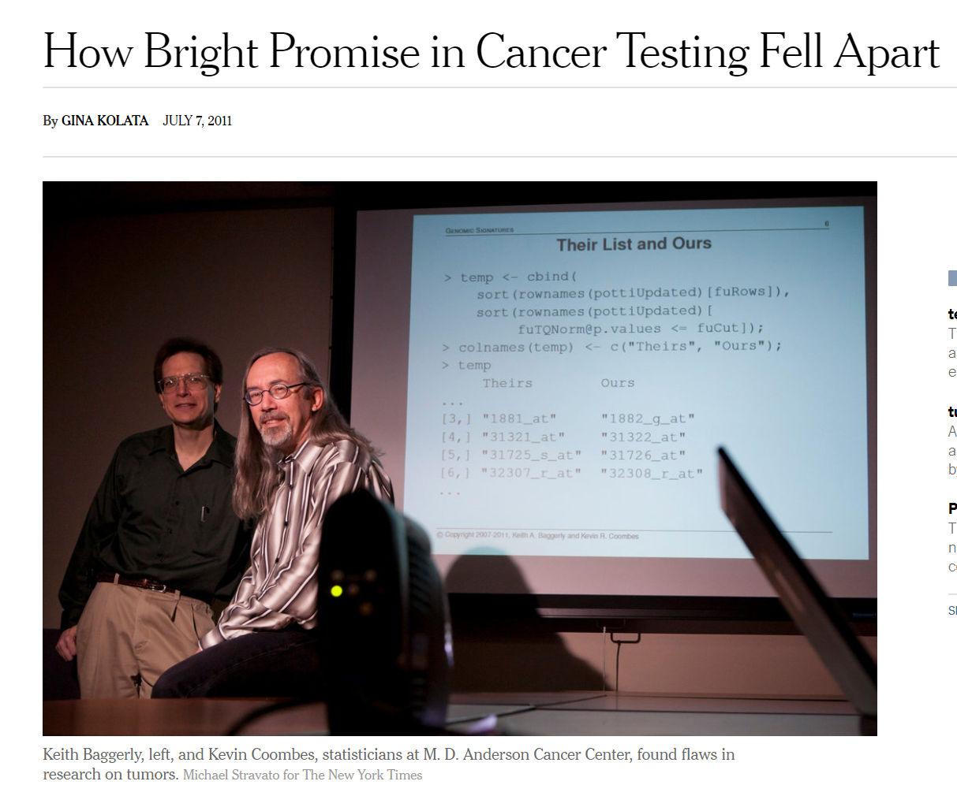
Notes:
So how did this all get uncovered?
When the Duke Cancer papers started coming out, investigators at other institutions were keen to use these methods for their own research questions. And a first step that researchers will often take is to independently reanalyze the data from a published study to see whether they get the same results.
And two of these researchers were Keith Baggerly and Kevin Coombes from MD Anderson.

Slide 11
Data
Reproducibility
Nature
Results
Notes:
So they started with the raw data, which was deposited in a publicly available repository, and then they tried to follow the steps outlined in the Methods section, but they got completely different results.
And they tried for a long time to sort out these inconsistencies with the authors of the paper, but, in Keith Baggerly’s words “The data didn’t add up.”
So the analysis, as reported, was (**) not reproducible.

Slide 12

Data
Forensic Bioinformatics
Nature
Results
Baggerly and Coombes, Ann Appl Stat (2009)
Notes:
When the MD Anderson team learned that these flawed predictive models were starting to be used in cancer clinical trials, they got concerned enough to start an extensive (**) “Forensic Bioinformatics” effort to prove that the models were unreliable and patients are being placed at risk.
And by “Forensic Bioinformatics”, what they mean is, (**) you completely ignore the Methods section, and ask the question: what must they have done with the raw data to get to the results that they report in the paper?
This was some painstaking detective work and according to Keith Baggerly they spent more than 1000 hours on this question.

Slide 13
Point-and-click tools are usually not reproducible
Notes:
(slow!) One of the main takeaways from this case study is… that a critical barrier to reproducibility is the tendency of investigators to use graphical user interface “point-and-click” type tools, like Microsoft Excel.
(**) Point-and-click type tools are usually not reproducible, because they don’t record user actions.

Slide 14
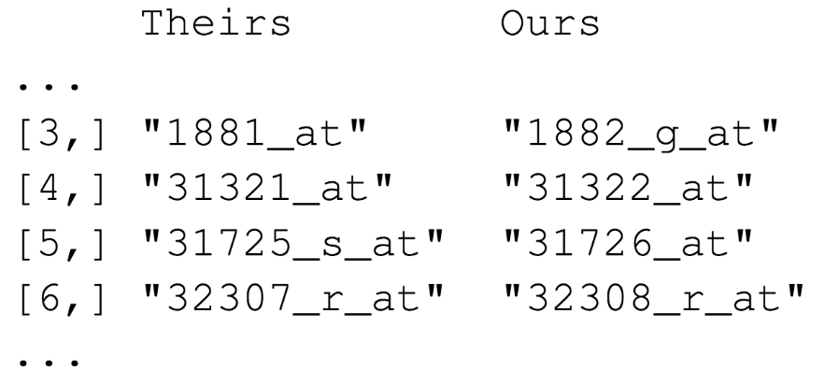

Team A
Team B
Off-by-one indexing error
Notes:
Let’s look at some of the kinds of errors that occur when you use non-reproducible methods such as Excel.
These are a few of the hundreds of microarray probe sets – each one corresponds to a gene – that the Duke investigators reported to predict sensitivity to 5-fluorouracil.
(**) And here are the probe sets that the MD Anderson team got. You can see that those two are different.
(**) If I highlight the last number of each probe, you can appreciate the pattern… who sees the pattern? Type your answer in the chat! …
The pattern is that the number of the probe set that Duke reported is exactly one less than the number of the probe that MD Anderson found.
(**) This is what’s called a off-by-one indexing error and is what happens when you copy and paste values from Excel one column at a time, and in one of the columns you grab the wrong starting row, and as a result all the values in the affected column are shifted by one. This is a simple error to make, but as you might imagine, this error completely invalidates all downstream results.

Slide 15
“Common problems are simple…
Off-by-one indexing error
Sensitive / resistant label reversal
Identical data shown more than once
Batch effect
Wrong heatmap shown
… and simple problems are common.”
Notes:
** fix this to show Excel errors. Data eliminated – out of bounds error; data
The off-by-one indexing error was just one of many simple errors the MD Anderson team discovered.
Another type of error that was pervasive in the study was label reversal. In more than one case, a cell line that was labeled as “sensitive” to a chemo drug was actually resistant, and vice versa. That type of error can lead to a scenario where a patient gets the chemotherapy that would be predicted to be least beneficial.
These are all pretty simple errors – you don’t have to be incompetent or negligent to make them. (**) And because they’re so easy to make, and without good documentation or a reproducible workflow it’s hard to catch them, they are also very common.

Slide 16
This should concern you.
Data
?
Nature
Results
Notes:
And I think that this is a cause of concern if have a professional responsibility to use clinical data to generate results that will affect patient care.
Because this can lead to scenarios where a well-meaning clinician argues in good faith for managing patients in a certain way, but the underlying analysis is flawed, and it results in a poor outcome.

Slide 17
Reproducible workflows help catch simple errors
Data
✓
Nature
Results
Notes:
Or, to put this more positively: if you routinely adopt a *reproducible* workflow, it’ll be much easier for you to weed out these kinds of simple errors that are so common in data analysis. And this means that you can be more confident that the analysis is valid.

Slide 18
Your Turn #1
Which one of the following statements is NOT true?
An off-by-one indexing error commonly occurs when a workflow requires copying columns from Excel and pasting into another application.
Label reversal errors commonly occur when a categorical variable is expressed as numbers (e.g., “0” and “1”) instead of names (e.g., “sensitive” and “resistant”)
Reproducibility has been proposed as a gold standard for scientific validity.
Both B and C
A
B
C
D
Notes:
Let’s do a quick Your Turn. Take a minute and read the prompt and then type the answer in the chat!
Test:
Understand mechanism of off-by-one indexing error
Understand mechanism of a label reversal error
Distinguish replicability vs reproducibility
C – correct.
A – confused replicability vs reproducibility AND does not understand the mechanism of an off-by-one error
B – confused replicability vs reproducibility AND does not understand the mechanism of a label reversal error
D – does not understand the mechanism of a label reversal error

Slide 19
Reproducible Data Analysis Workflows

Slide 20
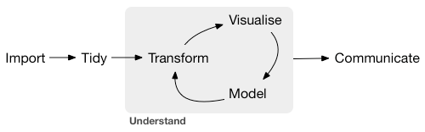
Data analysis life cycle
Define Objective(s)
Identify Data Source(s)
Wickham and Grolemund. R for Data Science (2017)
Notes:
Before we look at *reproducible* data analysis workflows, let’s create a conceptual model of a typical data analysis project. And this could be a research project or clinical operations, could be anything. It would go something like this.
You begin by roughly defining the goals and objectives of the project (**) and identify what data you need to meet these goals.
(**) Then you then import the data, which means bringing it into your your analytics software in some way.
(**) Then you tidy the data – by which I mean reshaping it for analysis and also performing data quality control.
(**) Usually the next step will be to transform the data in some way in order to prepare it for a specific analysis, perhaps filtering out patient visits from a specific year or hospital unit or combining two data tables, maybe one has treatments of interest, and the other one has outcomes of interest. Could be any number of things.
(slow) The two main engines of knowledge generation are visualization and modeling.
In a typical data analysis, transforming, visualizing, and modeling happens not only once, but over and over. This is what’s called the Understand cycle. The quality of the analysis depends on whether that cycle has been iterated a sufficient number of times to address the question that you're asking. For some things you really only have to go through this once or twice, but for example for building machine learning models you have to do this many, many times.
(**) The final critical piece is communication of the insights in such a way that they eventually get turned into action. And that could be through a publication, a report to a stakeholder, or some other way so that the analysis can be used for decision making.

Slide 21
A computational document is a document that contains executable computer code.
Notes:
(slow) A computational document is a document that contains executable computer code.

Slide 22



R
Programming language for
data analysis
R Markdown
Computational document format
(uses R for executable code)
RStudio
Editor for writing
R Markdown
Notes:
Before I show you what a computational document looks like and how it fits into a reproducible workflow, let me introduce 3 terms that may or may not be new to you.
The first is R. R is a programming language for data analysis. There are lots of things that make R our preferred language at CHOP: it is freely available, makes it easy to wrangling complex data sets, and can produce publication-quality visualizations. Also, you can use R to pull data from any of the databases that are being used at CHOP, such as Epic, our lab information system, and our clinical data warehouse.
There is also an open and welcoming community of people who use R.
And doing basic data analysis with R is actually not that difficult to learn, even if you’re not a computer programmer and have never written a single line of code.
(**) Then, there’s R Markdown. R Markdown is a computational document format that has executable code usually written in R. I say usually because it’s actually possible to write code in Python and other languages inside of an R Markdown document, if that's what you wanna do.
(**) Finally, there’s RStudio. RStudio is the name of a company and also the name of a piece of software this company makes and makes available for free. You can think of RStudio as a fancy editor for writing R and R Markdown. You can run RStudio on Mac or Windows, or, if you’re concerned about protecting patient data or intellectual property, it’s possible to lock down an RStudio server behind the hospital firewall.
By the way, if you're interested in installing R and RStudio on your computer after today, I put links for this on a website I made for this lecture.

Slide 23
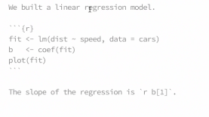
Better to show an example of an actual report, like this?
Notes:
An R Markdown document is a regular text file that has “marks” to add styling. For example, here we see one or two of hashtags at the beginning of a line. These hashtag tell R Markdown: this is a level one or a level two header.
Similarly, the asterisks at the beginning of the line signify bullet points.
A key idea is that you can convert an R Markdown document into a final target format for viewing. (**) And here’s what the R Markdown on the left would look like converted to HTML. And HTML is the format that web browsers use, and it's the default target format of R Markdown.
So, R Markdown is a computational document format. So anybody can tell me what else should we be able to include? Type in the chat! …
Exactly! We should be able to include executable computer code. And I promise, I’m going to write a question for the American Board of Pathology, that’s going to ask exactly that, and now you know the answer.
(**) So you can add computer code to R Markdown in what’s called a code chunk. This code here – I’m only showing it to illustrate, don't worry about how it works – is some R code that generates 100 normally distributed random numbers and assigns them to a variable called x. And then calls the summary function on x.
As you can see, in the rendered document the code chunk is placed neatly in a gray box to make it visually distinct from the marked up narrative text.
(**) R Markdown also runs the code and shows the result right below the code. This way, you get a neatly formatted report that shows the code and the results of the code right below any text you might write to explain what the code does and why you've written it the way you did.
(**) You can also include plots and other graphical elements. Here we’re running the hist function on x, and the rendered document shows a histogram of the values in x.
Let’s do a quick demo to see what this would look like if you had R installed on your computer.
***DEMO 1
- Create R Markdown doc
- Change some text: Hello UAMS!
- Knit to HTML
- Knit to PDF

Slide 24


R Markdown for reproducible workflows
Define Objective(s)
Identify Data Source(s)
Notes:
We use R Markdown as the substrate for reproducible data analysis workflows. You can imagine the blood bank director and analyst collaborating on a single R Markdown document that contains all of the code to load the initial data, make data transformations, and create summary tables and graphics for the audit.

Slide 25

Domain expert
Technical user
Notes:
Now data analysis usually happens as a collaborative effort. Usually you have some sort of a domain expert – in the hospital this could be an attending or a lab director – and a technical user – which could be an analyst or a technologist, or often times a trainee. And sometimes the one person plays both of these roles.
But for the sake an an example, let’s say that you have a blood bank director who asks an analyst to compose an audit of last year’s transfusion reactions.

Slide 26

Traditional workflow
Define Objective(s)
Identify Data Source(s)
Notes:
So the director might send a list of patients who have had transfusion reactions to the analyst, (**) and often times that list will be an Excel sheet. The analyst then goes through the list and might manually add columns with relevant data, creating their own version of the sheet.
(**) This effectively creates a silo that the domain expert has no insight into, and as we’ve seen errors will likely be made in this silo that will be hard to spot because we’re using Excel which doesn’t record user interactions.

Slide 27
Reproducible workflow
Define Objective(s)
Identify Data Source(s)
Notes:
Imagine that instead, you could eliminate Excel from the intermediate steps of data analysis and have the lab director and the analyst work together on each step of the data analysis, and you had a way to ensure that the entire analysis can be automatically reproduced by a computer at any point of the project, and you have the code and the reasoning available for inspection at all times.
This reproducible workflow would allow closer collaboration, more transparency, and also save time by catching data problems earlier, and more rapidly iterating through the analysis by eliminating much the back and forth spent in trying to communicate what was technically done rather than getting to the results.
This workflow is made possible by eliminating the spreadsheets and adopting a new tool known as the “Computational Document”.

Slide 28



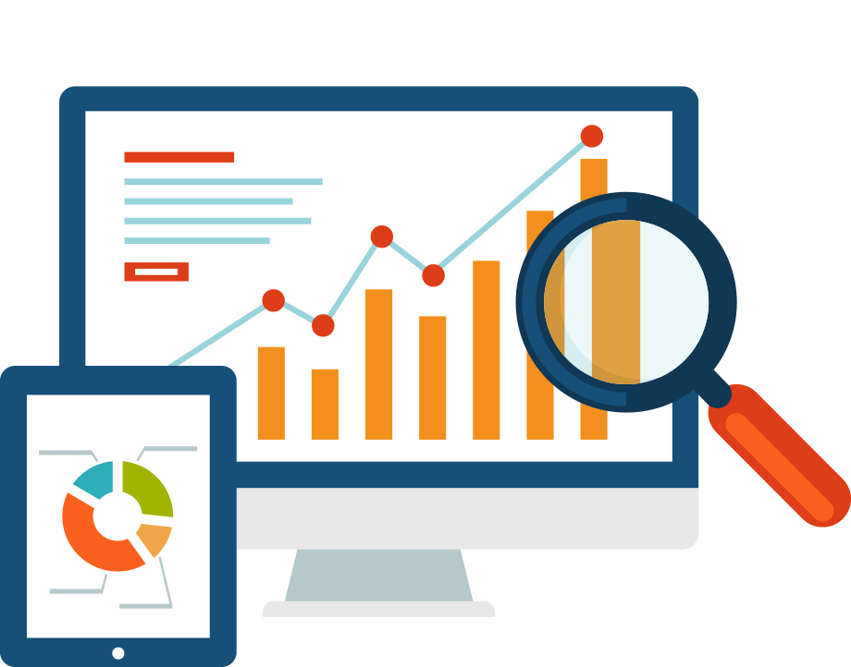

Notes:
As I’ve just shown, you can “knit” R Markdown documents into a bunch of different formats, such as (**) HTML, (**) PDF, but also (**) Microsoft Word, and (**) PowerPoint. And even (**) interactive dashboards.

Slide 29


Deploying R Markdown Dashboards
shinyapps.io (free)
Shiny Server (free)
RStudio Connect ($)
Notes:
The way this works is that your R Markdown document gets knitted into an HTML file, as I've just shown you, but then it uploads that HTML file to a server that makes it available to the internet or maybe your internal private network.
You can deploy your dashboards either in the cloud or on premise. If you want to deploy a dashboard that’s public-facing and doesn’t show any sensitive data, there is a free service called Shinyapps.io.
For internal-facing apps that may contain sensitive data you can either use Shiny server, which is free, or RStudio Connect, which is a commercial product. At CHOP, our Analytics department manages an RStudio Connect instance, and we can host all of our internal facing dashboards there.

Slide 30
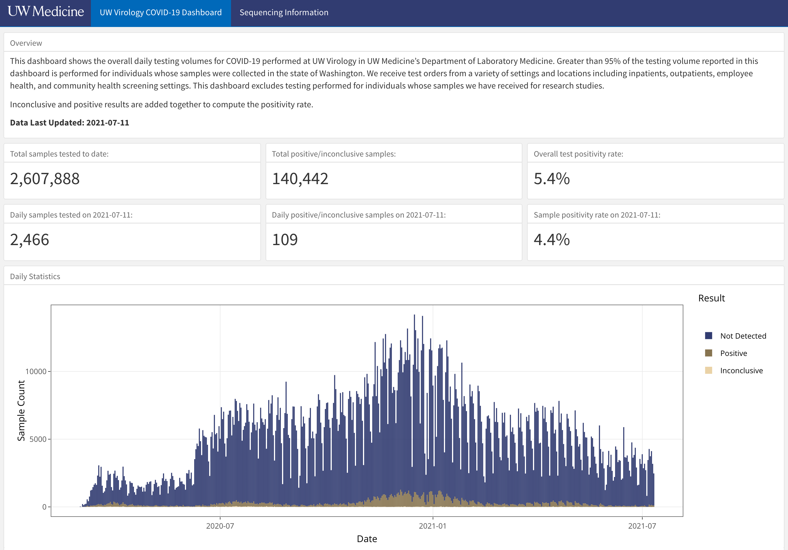
Notes:
Dashboards are a great way to communicate results because they display key data on demand, and they are increasingly being used by clinical laboratories, like for example this COVID19 testing dashboard of the University of Washington Lab Medicine Virology lab.
This dashboard is written in R Markdown, but you don’t need to know any R to use it. You just point your browser to its web site, and then you can see at a glance some key performance indicators, such as total samples tested to date, which as of yesterday is a whopping 2.6 million; and other numbers such as test positivity rate, daily positives, and so on.
In addition, there's a histogram of test volume over time, color coded by result. What I can’t show here because it’s a PowerPoint, is that the histogram is actually an interactive plot that lets me zoom in and get more detailed information by hovering over specific bars.

Slide 31
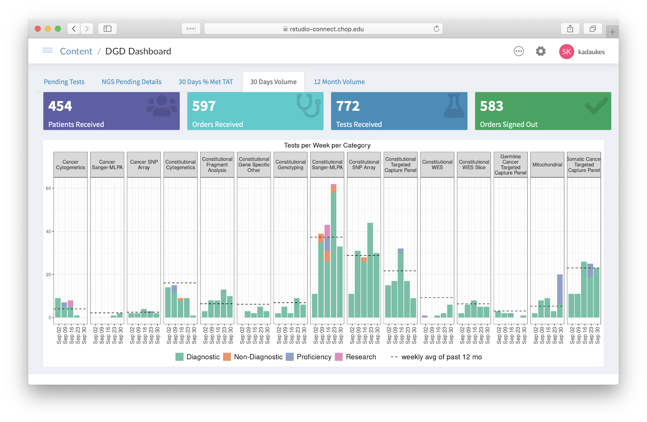
Notes:
At CHOP, we have created a number of dashboards that are either written entirely in R Markdown or were at least prototyped in it.
Here’s a dashboard of the Division of Genomic Diagnostics that displays test volumes and turn-around times for the various molecular tests we do.

Slide 32
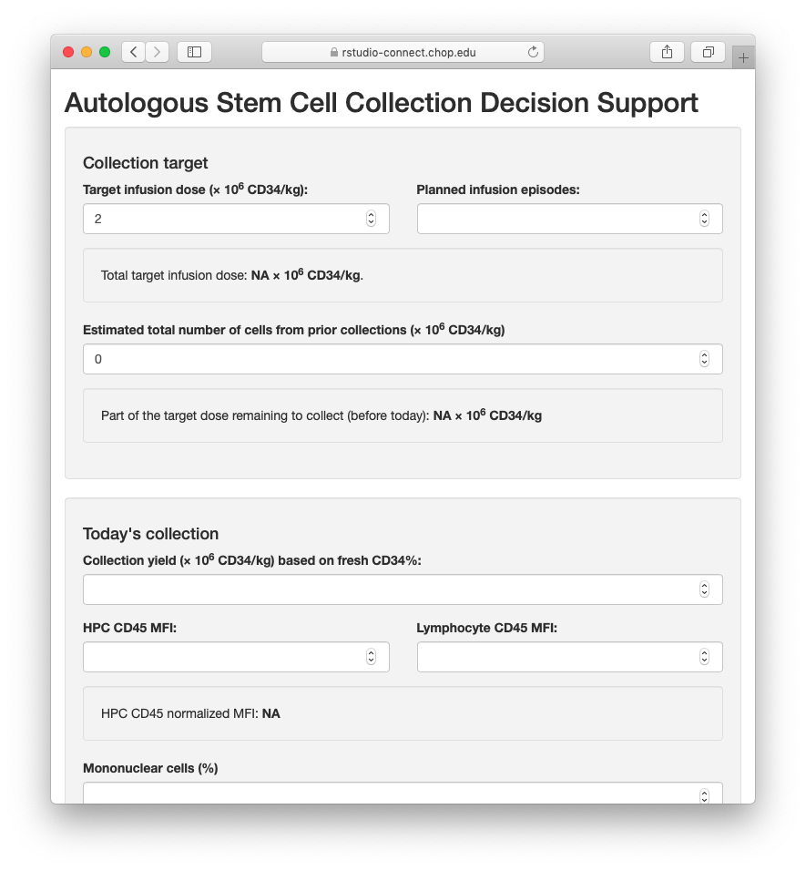
Custom-build the last 10% of your LIS
Notes:
One area where R Markdown powered dashboards shine is when a lab information system provides 90% of the necessary functionality, and you need to custom-build the remaining 10%.
Here’s a dashboard we created to support the bone marrow transplant physicians in deciding whether or not a stem cell collection is complete or more stem cells need to be collected the next day, by implementing a predictive algorithm that takes into account specific clinical and lab data. We’re still in testing, but think this will eventually reduce the number of unnecessary stem cell collections significantly.

Slide 33

Notes:
I really believe that that knowing just a little bit of coding, especially with R and R Markdown, is really powerful if you’re a lab leader. Because then you can take more effective ownership and be actively involved in developing and implementing these kinds of tools.

Slide 34
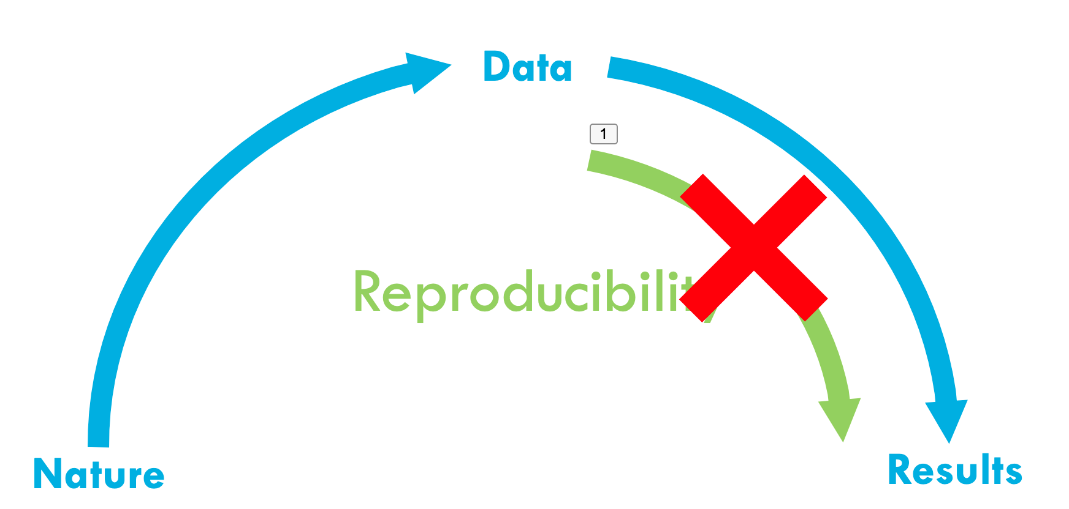
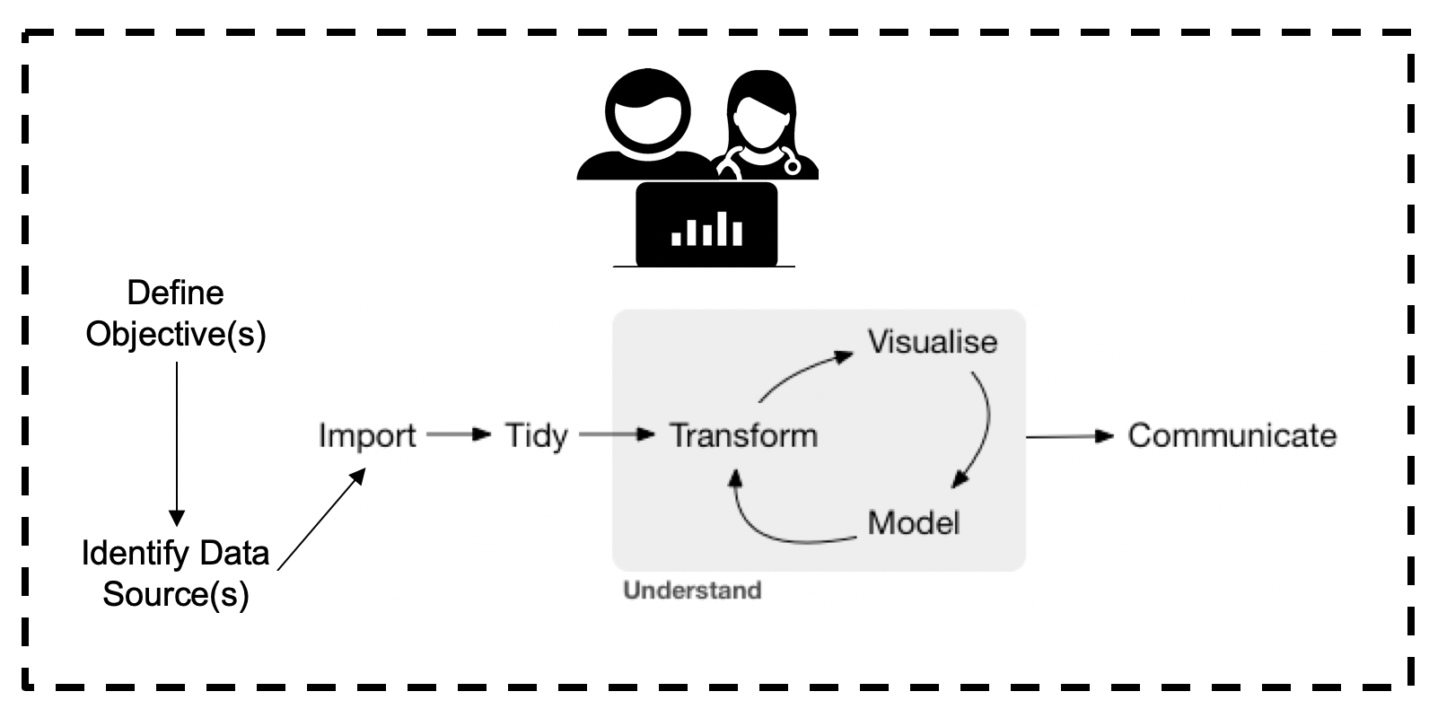
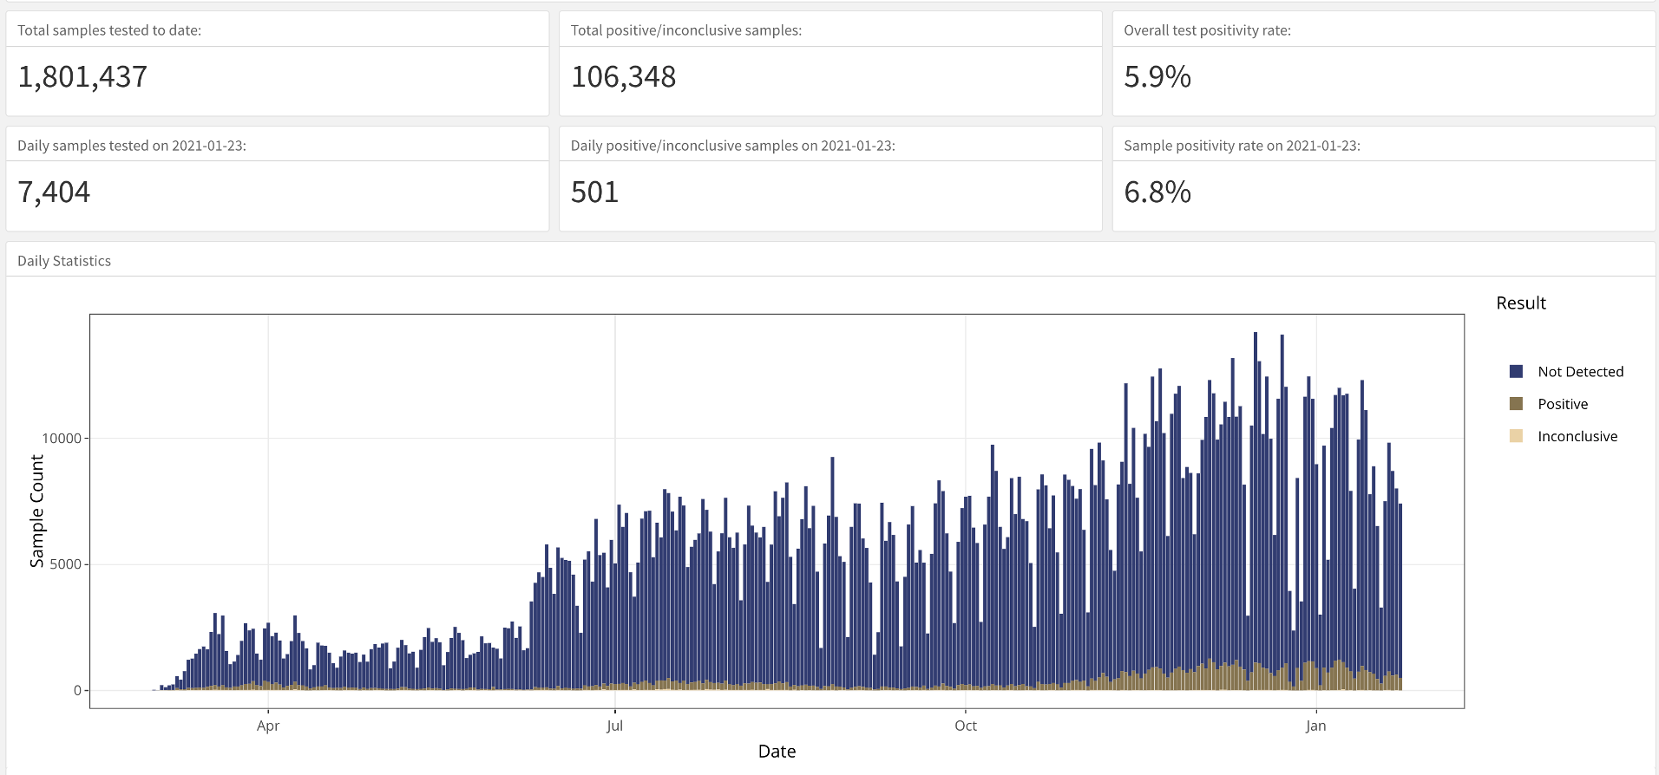
Recap
Analyzing data with Excel can compromise data quality that may lead to patient harm.
A reproducible workflow can improve confidence in the validity of an analysis.
The computational document is the substrate of reproducible workflows. R Markdown is computational document format commonly used in lab medicine.
Dashboards can support lab operations and can be written on R Markdown. Knowledge of R Markdown can help lab leaders build more effective dashboards.
Notes:
To recap what we covered up to this point, …
(**) Analyzing data with with Excel, or similar spreadsheet software, can compromise data quality, and may ultimately lead to patient harm. This is because Excel does not record user interactions and it’s easy to make simple errors that can be very difficult to uncover later.
(**) Instead, you could use a reproducible workflow in which the entire analysis is automated with computer code, and we looked at how doing that can improve your confidence in the validity of an analysis.
(**) A “computational document” is a document that contains executable computer code. The computational document is a key ingredient of reproducible workflows. R Markdown is a computational document format that’s commonly used in lab medicine.
(**) And finally, we looked at dashboards, which can support lab operations and can be built with R Markdown. Knowledge of R Markdown can therefore help lab leaders build more effective dashboards.

Slide 35
Your Turn #2
Which one of the following statements is NOT true?
R is a programming language for data analysis, and R Markdown allows documenting and presenting the reasoning, code, and results of an analysis.
The “Understand” cycle describes the iterative process of data analysis in which data are repeatedly tidied, visualized, and modeled.
In R Markdown, one hashtag (#) at the beginning of the line signifies a large (“level 1”) header line, and two hashtags (##) a smaller (“level 2”) header.
Both B and C
A
B
C
D
Notes:
So let’s do another Your Turn. Again, take a minute and type your answer in the chat!
Test:
- Distinguish R vs RStudio
Distinguish R vs R Markdown
Conceptually understand the “understand” cycle, and distinguish between “tidying” and “transforming”

Slide 36
R Markdown Practice
Notes:
For the last part of this session, let’s practice writing some R Markdown.

Slide 37


I’m done with this step!
I’m stuck, please assist.
Notes:
This practicum is a little bit experimental, and specifically I haven’t done it with Teams before so fingers crossed everything will work. What I’d like to do is, let’s try to get into the training environment step by step. When you’re done with a specific step, let me know with a thumbs-up; and if you’re stuck show me a raised hand, and I’ll try my best to troubleshoot.

Slide 38
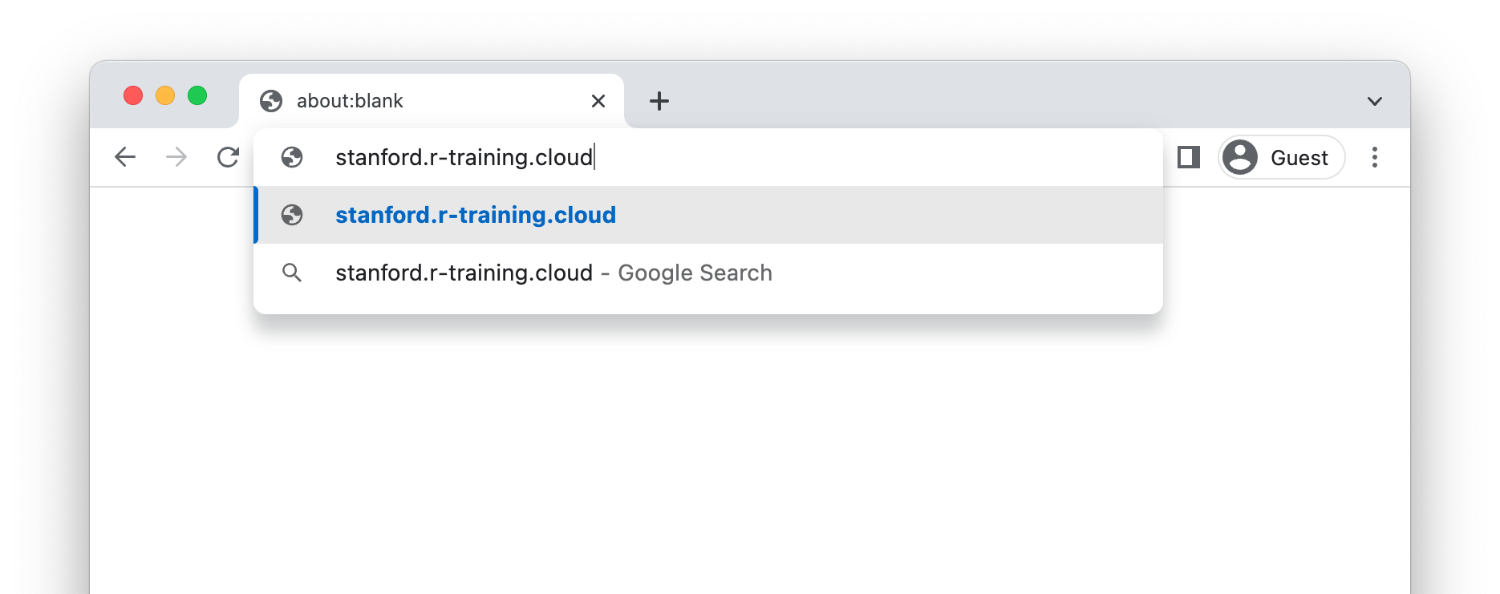
Point your browser to:
stanford.r-training.cloud
Notes:
Paste into chat: https://stanford.r-training.cloud

Slide 39
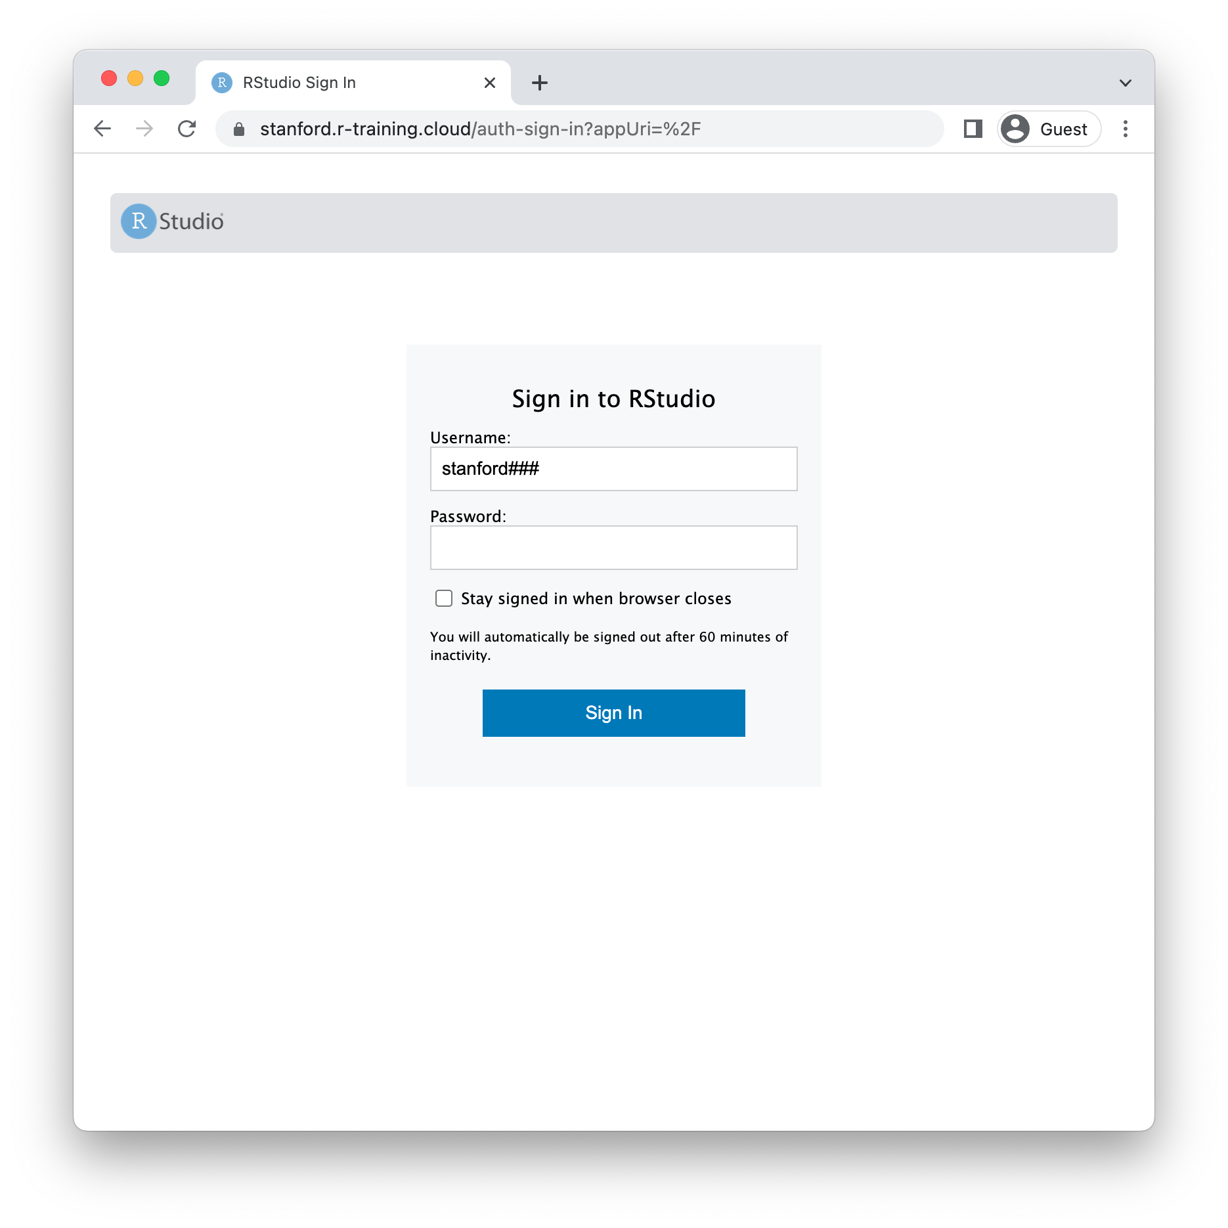
Find your login and password in the Teams chat and enter here
Notes:
** Paste usernames and passwords into Teams chat **. I just pasted a list of usernames and password in the Teams chat. Usernames start with lower-case ‘uams’ followed by three numbers. Passwords and six digit numbers. Find the one next to your name. Hoda gave me a list of folks who’d be at the lecture, but if you can’t find your name in the list, let me know in the chat!
** Use 011-050 for in-person folks. Use 051+ for online folks.
user stanford011 password 131081
user stanford012 password 237135
user stanford013 password 762115
user stanford014 password 101022
user stanford015 password 452082
user stanford016 password 516244
user stanford017 password 449329
user stanford018 password 462236
user stanford019 password 261067
user stanford020 password 956491
user stanford021 password 508354
user stanford022 password 394076
user stanford023 password 968872
user stanford024 password 736732
user stanford025 password 680087
user stanford026 password 450845
user stanford027 password 728688
user stanford028 password 589651
user stanford029 password 303820
user stanford030 password 536101
user stanford031 password 813705
user stanford032 password 105388
user stanford033 password 268941
user stanford034 password 713649
user stanford035 password 433093
user stanford036 password 425462
user stanford037 password 881914
user stanford038 password 913738
user stanford039 password 655681
user stanford040 password 220628
user stanford041 password 803973
user stanford042 password 486278
user stanford043 password 934545
user stanford044 password 795918
user stanford045 password 333712
user stanford046 password 389101
user stanford047 password 154175
user stanford048 password 139110
user stanford049 password 149548
user stanford050 password 662987
user stanford051 password 968022
user stanford052 password 844571
user stanford053 password 383525
user stanford054 password 291722
user stanford055 password 759245
user stanford056 password 549316
user stanford057 password 756794
user stanford058 password 172302
user stanford059 password 491977
user stanford060 password 312922
user stanford061 password 812410
user stanford062 password 332815
user stanford063 password 987384
user stanford064 password 781185
user stanford065 password 981799
user stanford066 password 297052
user stanford067 password 953835
user stanford068 password 234512
user stanford069 password 640320
user stanford070 password 951786
user stanford071 password 719517
user stanford072 password 554979
user stanford073 password 435642
user stanford074 password 402224
user stanford075 password 143426
user stanford076 password 657052
user stanford077 password 965301
user stanford078 password 689463
user stanford079 password 559262
user stanford080 password 235088
user stanford081 password 883402
user stanford082 password 562996
user stanford083 password 107783
user stanford084 password 117275
user stanford085 password 230060
user stanford086 password 374528
user stanford087 password 843090
user stanford088 password 552109
user stanford089 password 823214
user stanford090 password 154575
user stanford091 password 935158
user stanford092 password 827359
user stanford093 password 170931
user stanford094 password 640834
user stanford095 password 743301
user stanford096 password 562460
user stanford097 password 748104
user stanford098 password 774950
user stanford099 password 186076
user stanford100 password 458042

Slide 40
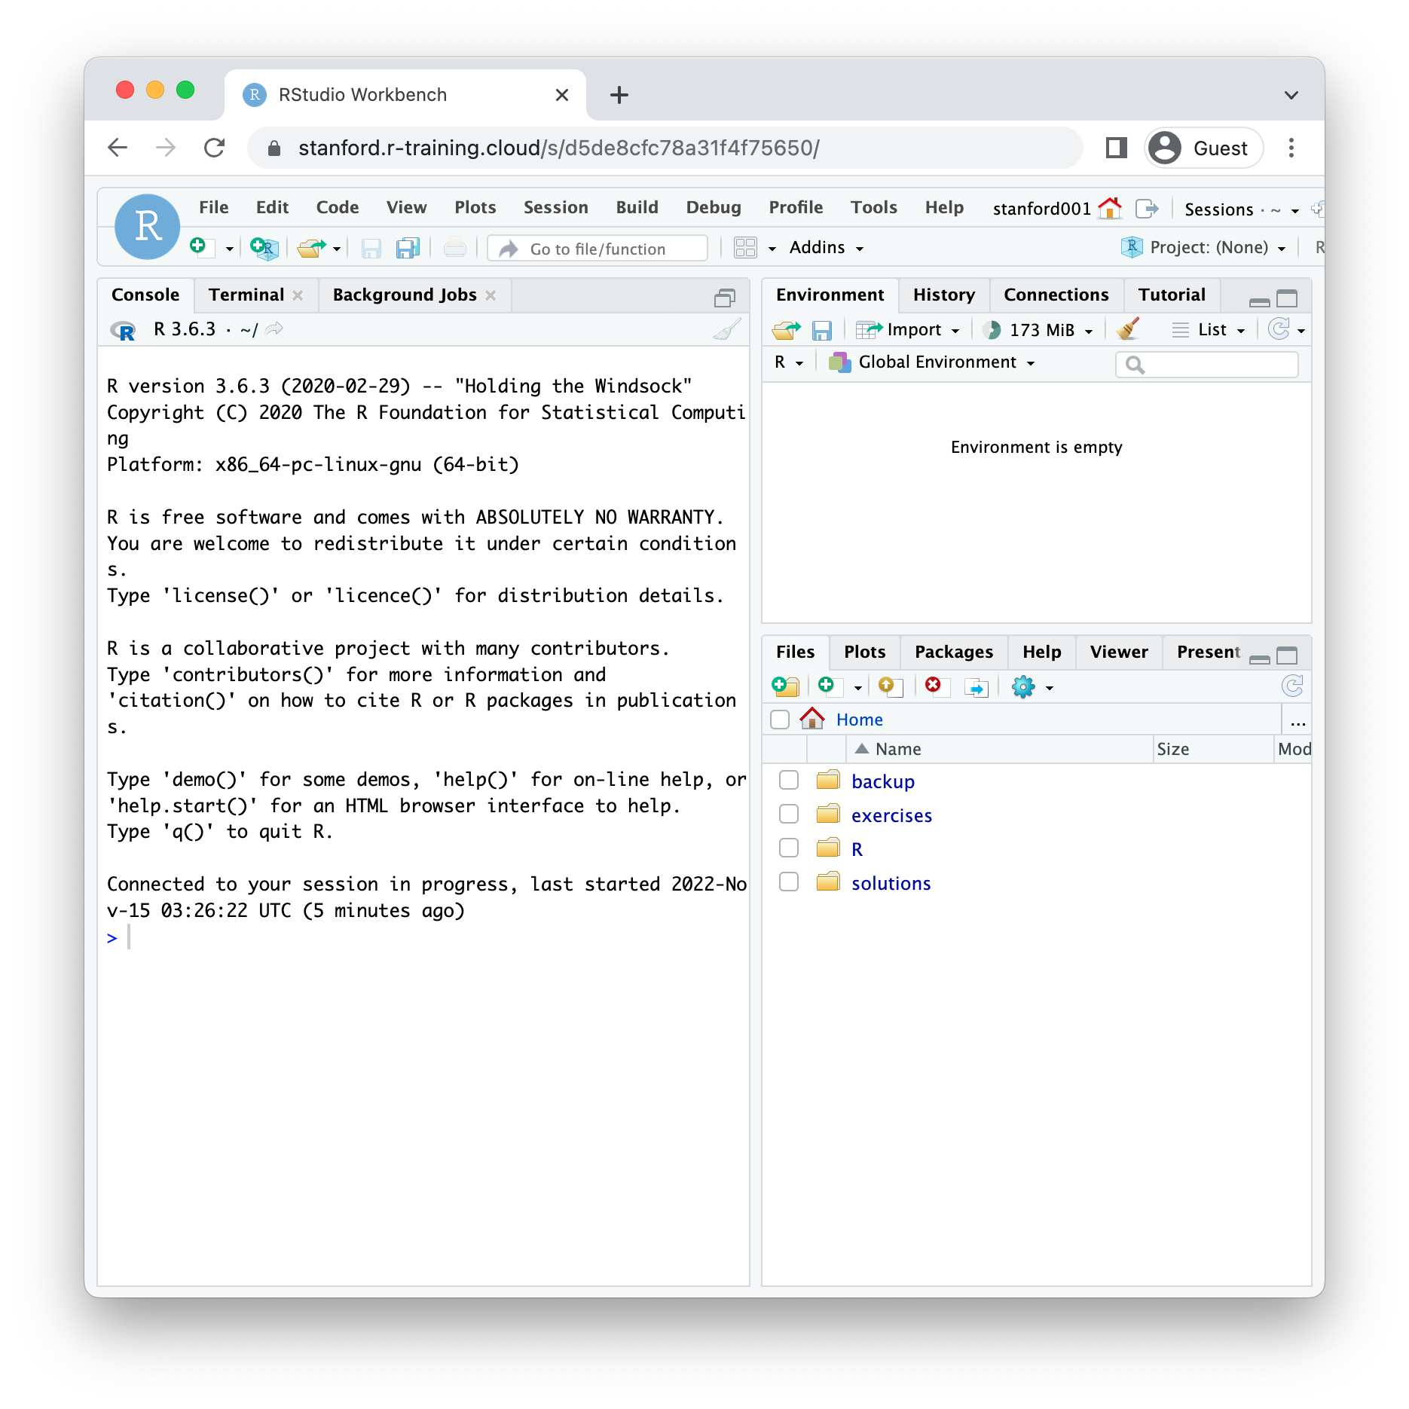
New Document

Slide 41
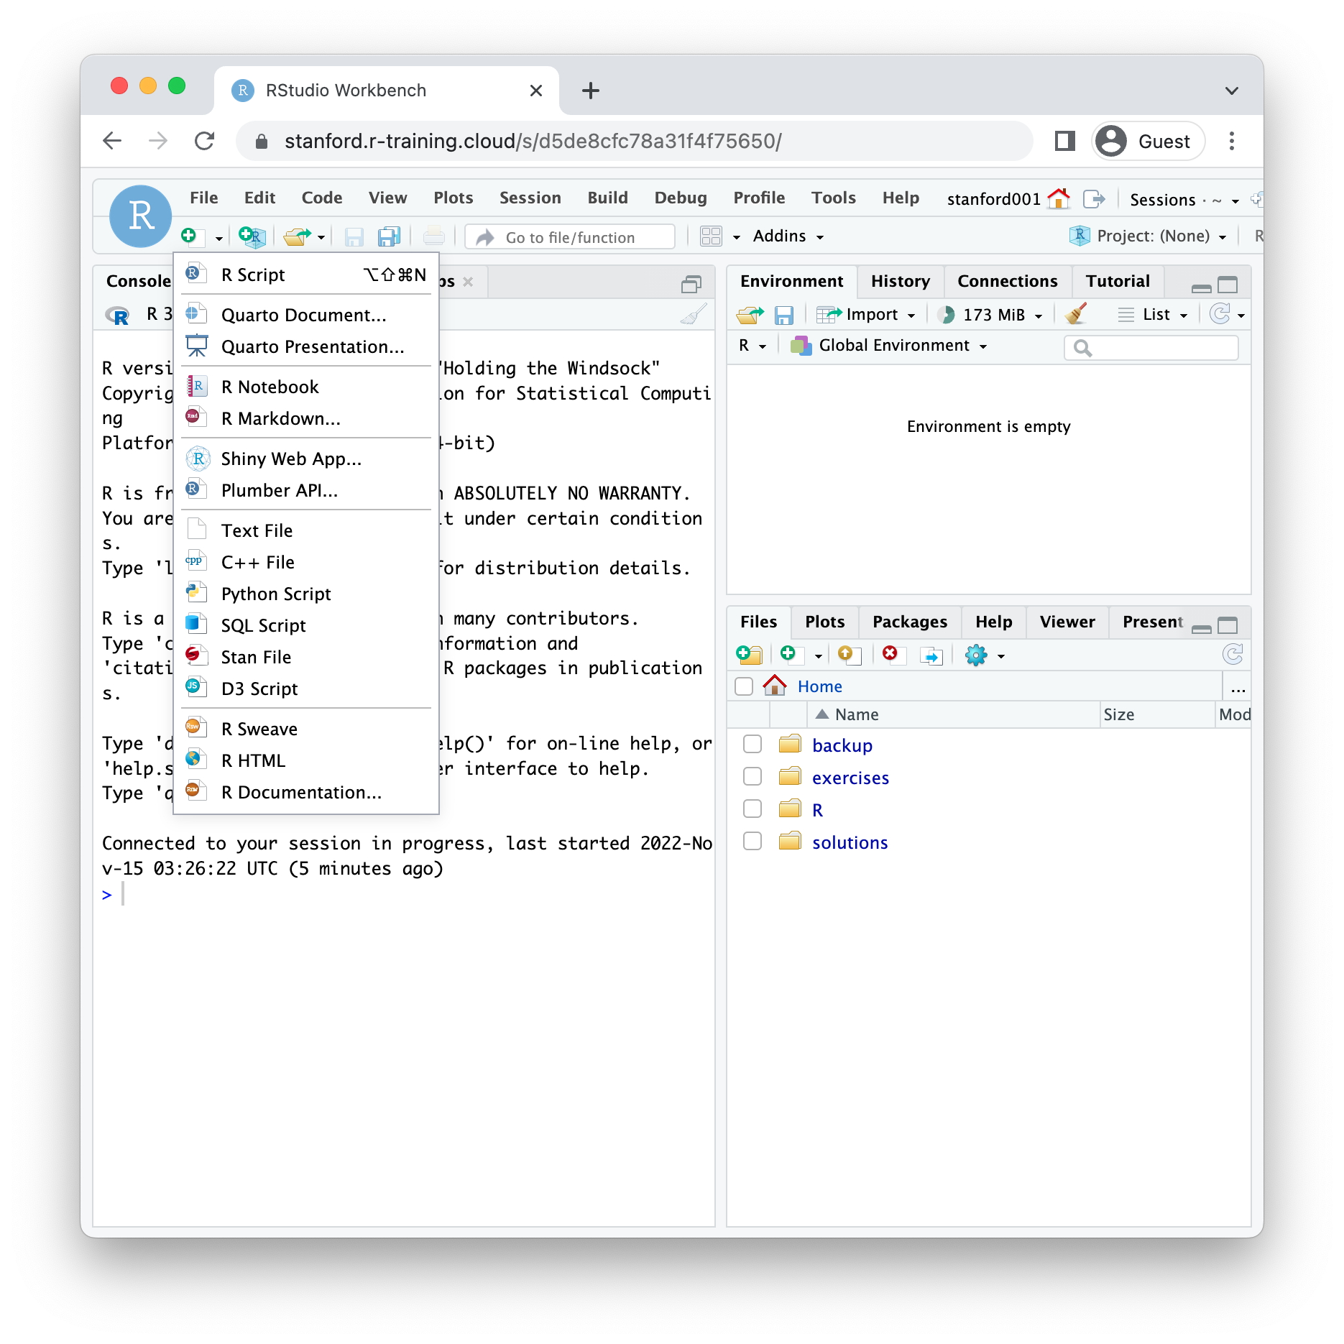
Select “R Markdown”

Slide 42
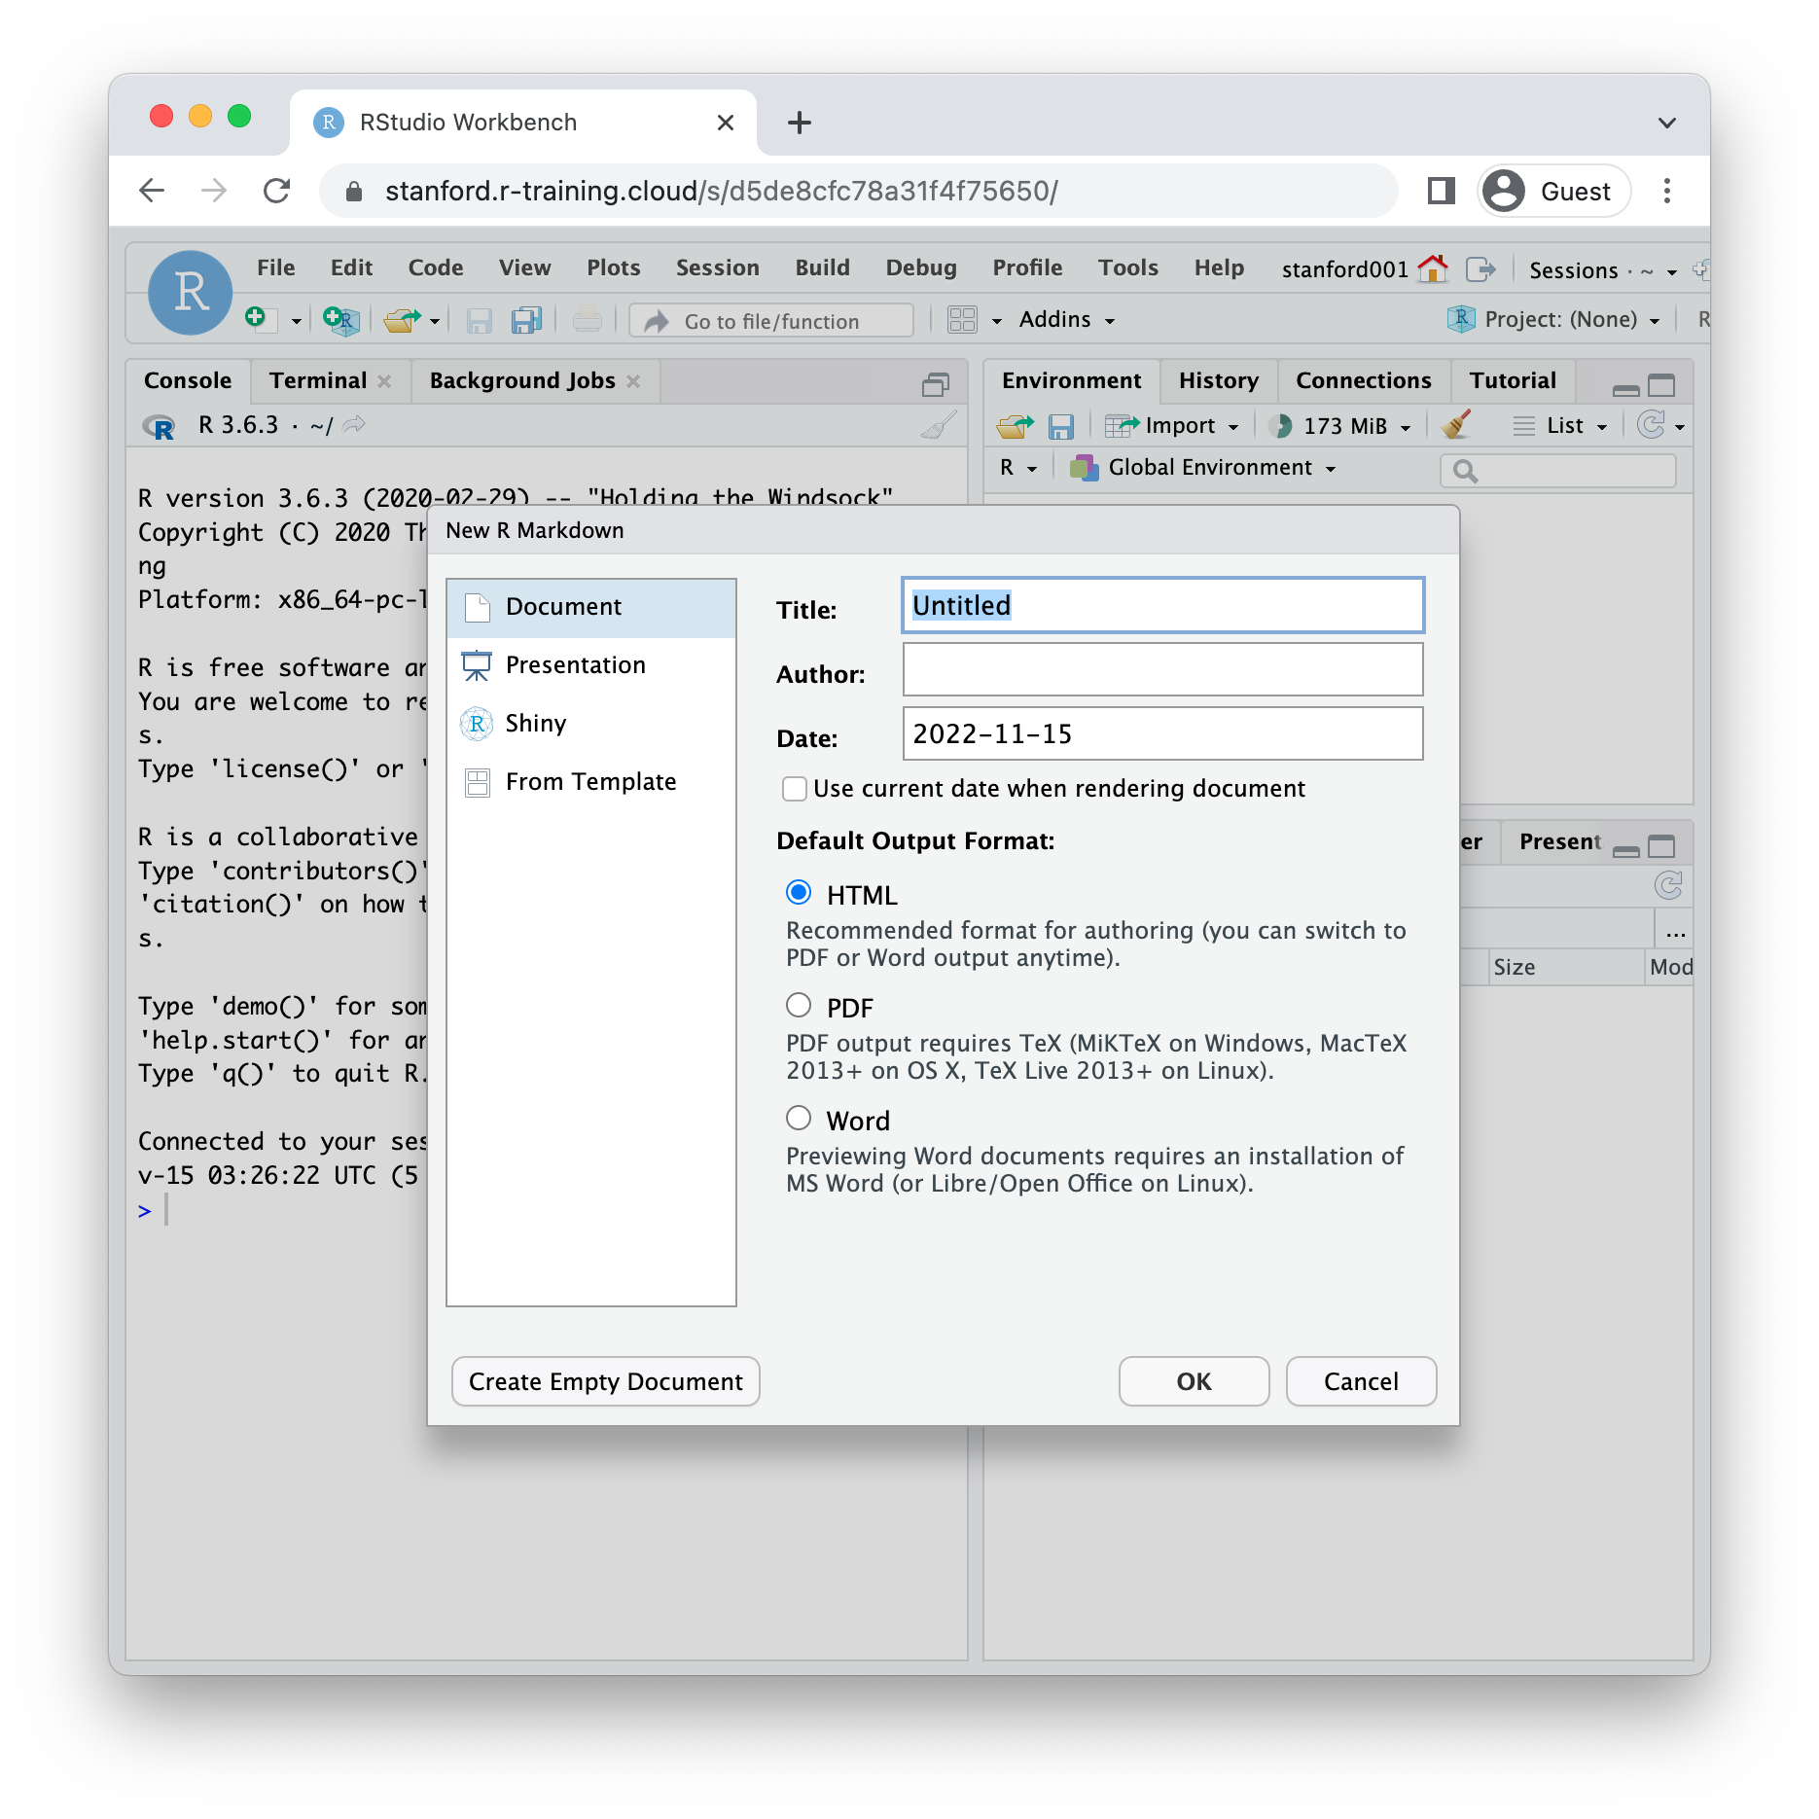
Click “OK”

Slide 43
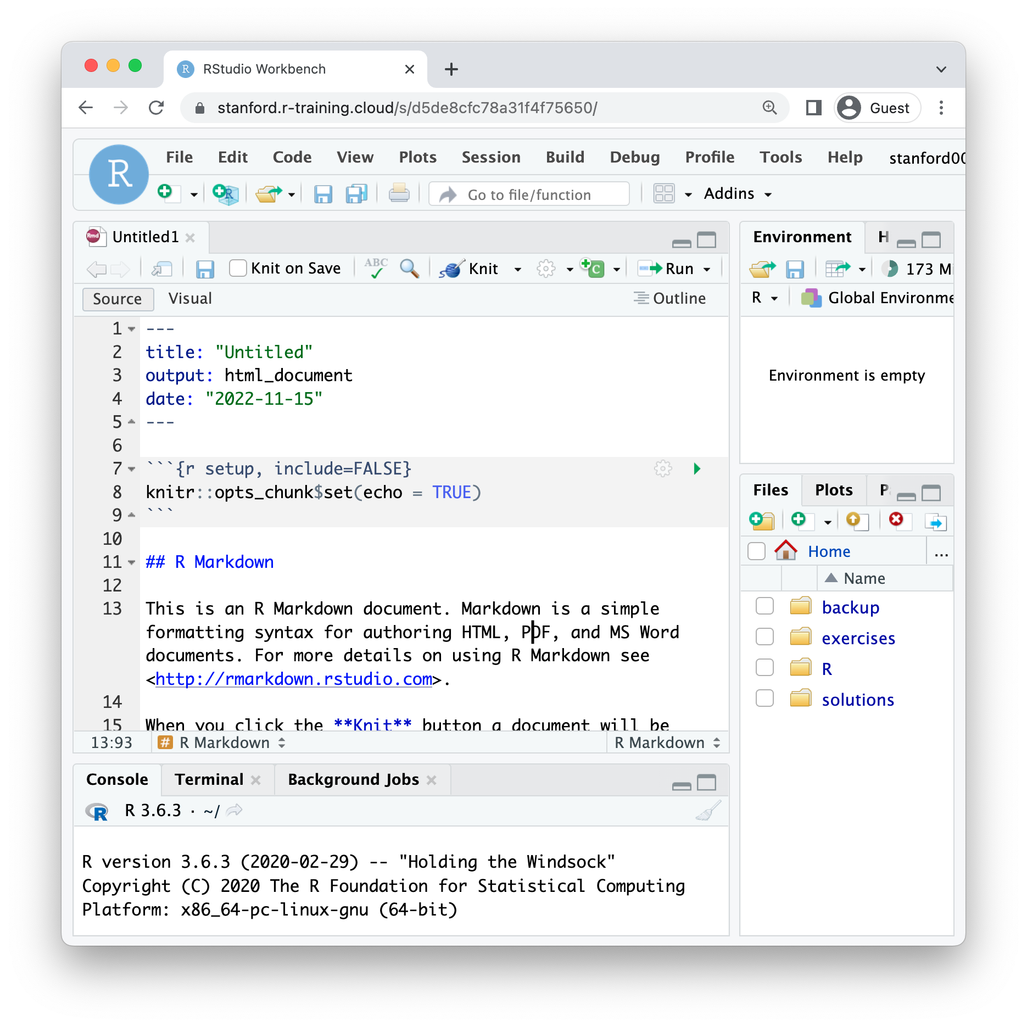
header
code chunk
Notes:
Point out two features:
(**) Header
- always at the top of the document
starts and ends with a line that has 3 dashes
Tells R Markdown what to use as the title of the document and what kind of document it is
(**) Code chunk
Always starts with 3 back ticks followed by the letter r in curly brackets
Ends with 3 backticks
RStudio editor makes it gray to make it visually distinct from the narrative text

Slide 44
Click “Knit”

Slide 45
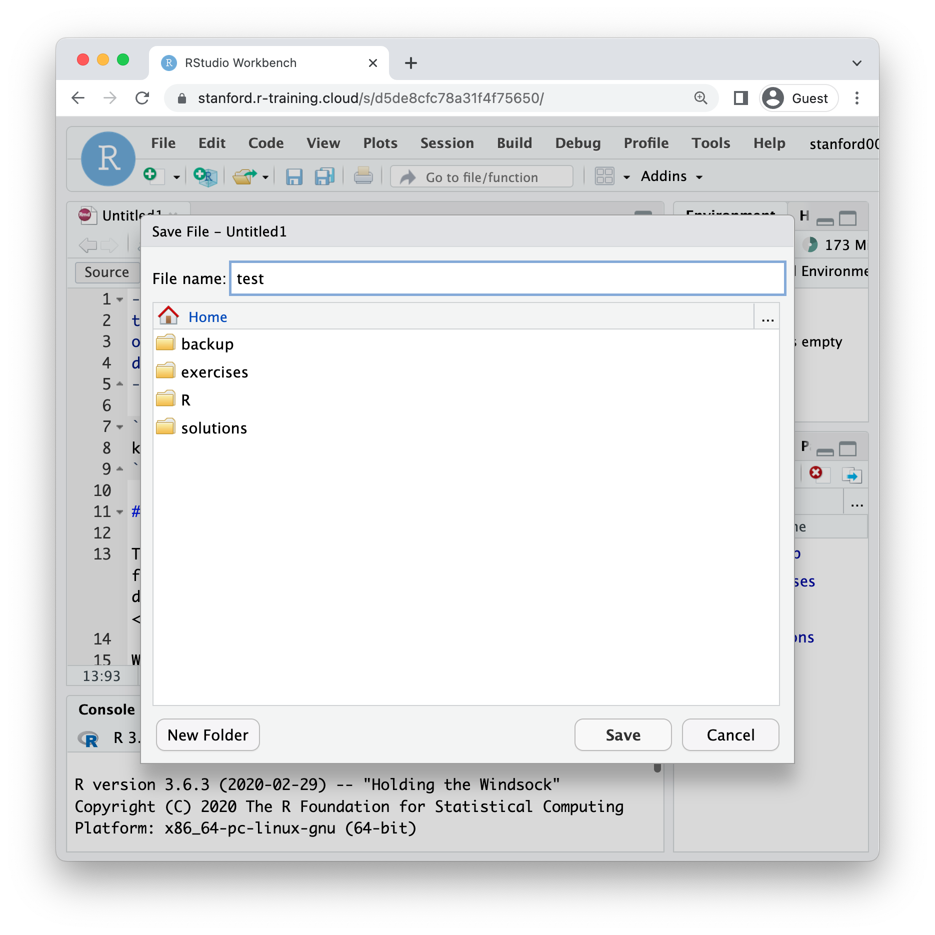
Enter any name, e.g. “test” and hit enter

Slide 46
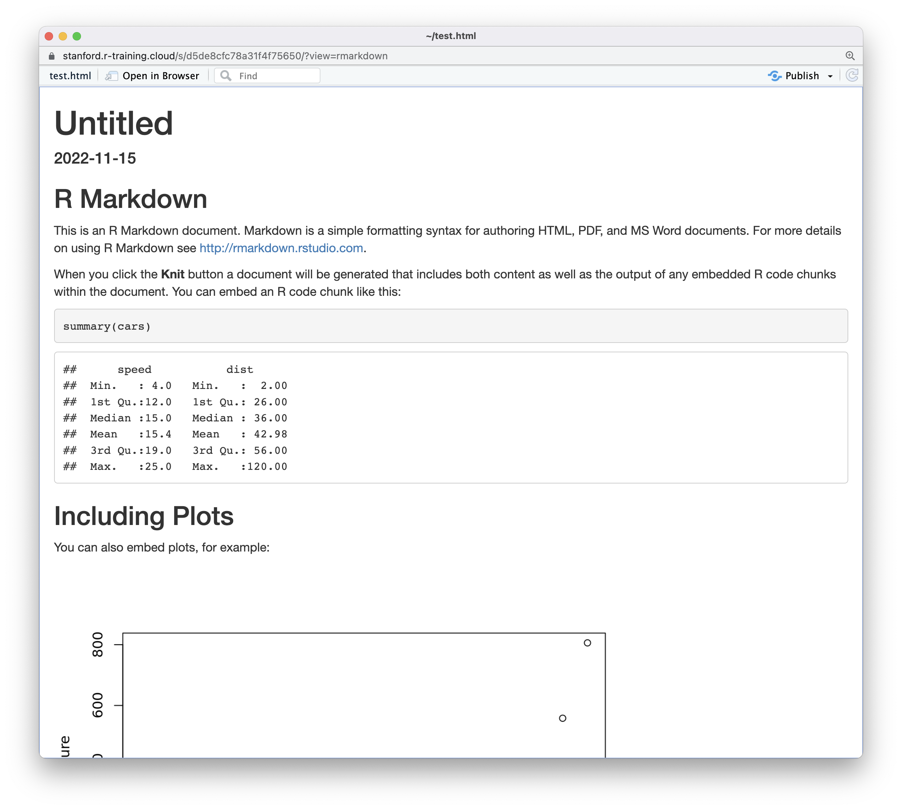
Notes:
Congrats! You knitted your first R Markdown document. (May get a message: popup disabled – try again? Yes)

Slide 47
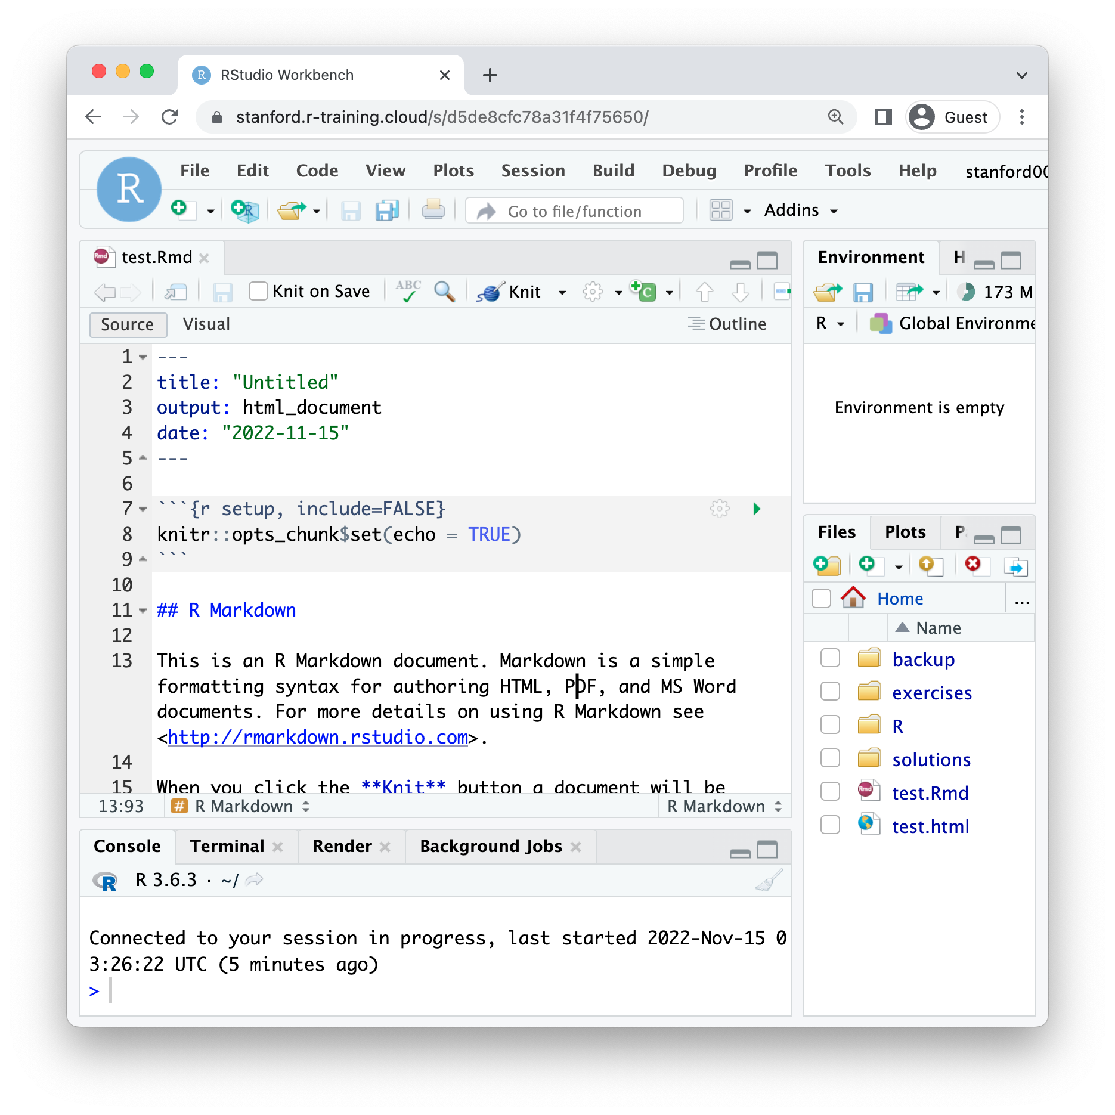
Click “exercises”
Notes:
X out the window -

Slide 48
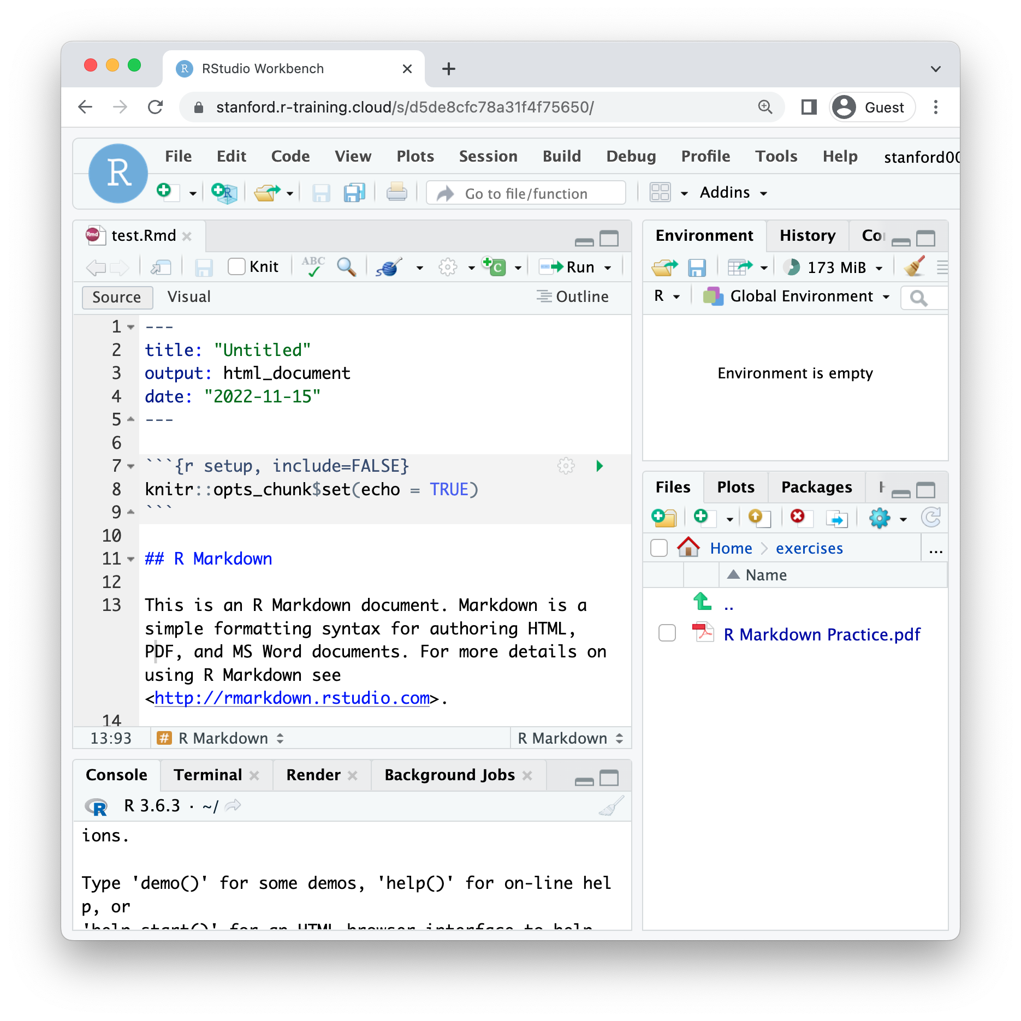
Click “R Markdown Practice.pdf”

Slide 49
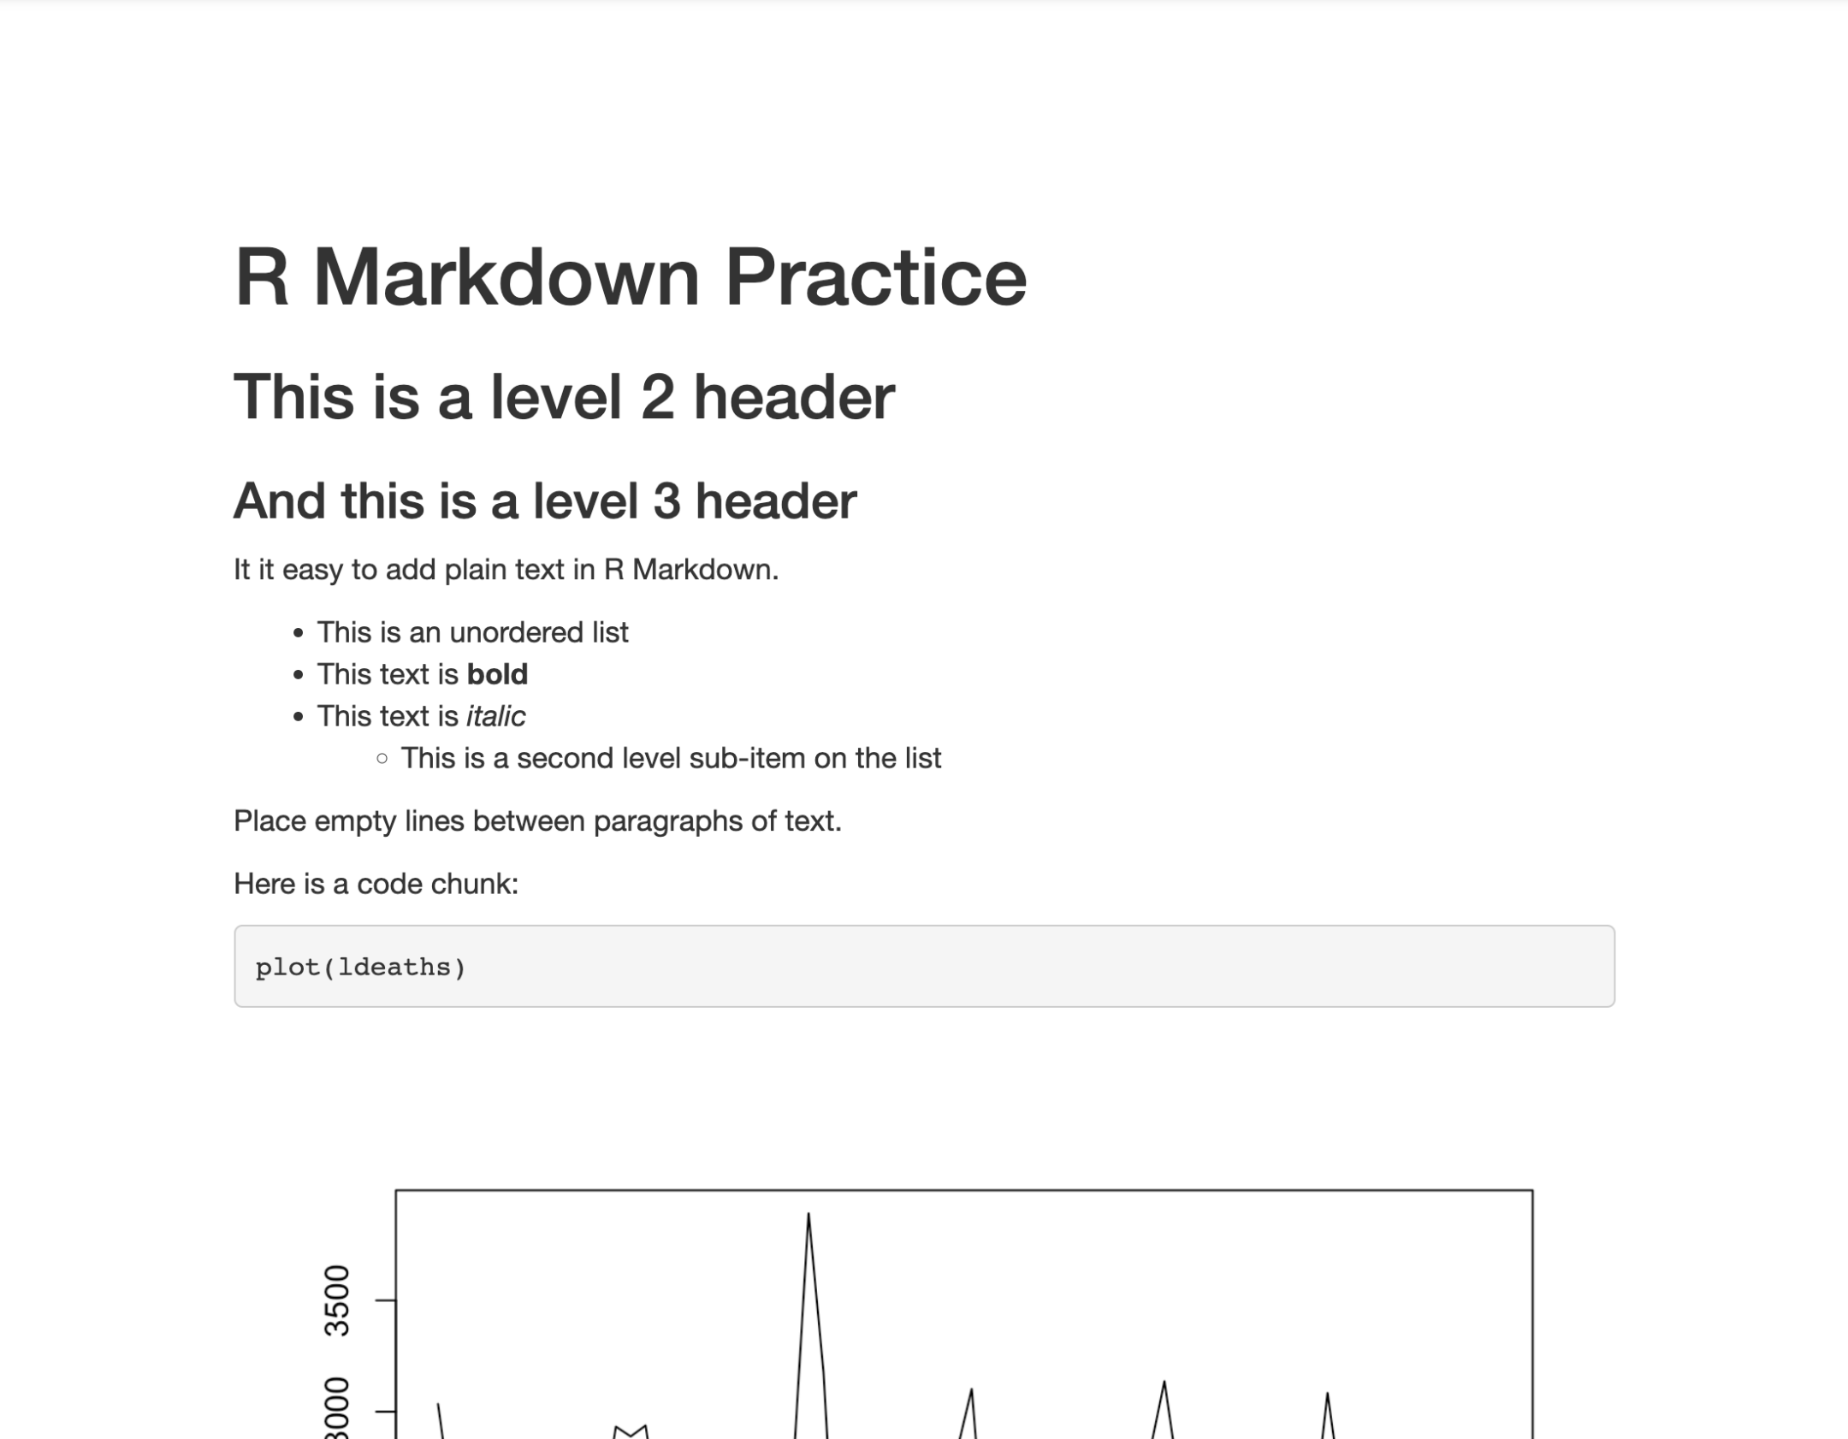
Notes:
This should open in a new browser tab…
Now, and this is going to be completely optional…
Go back to the editor, delete everything below the header, and try to re-produce this document.

Slide 50
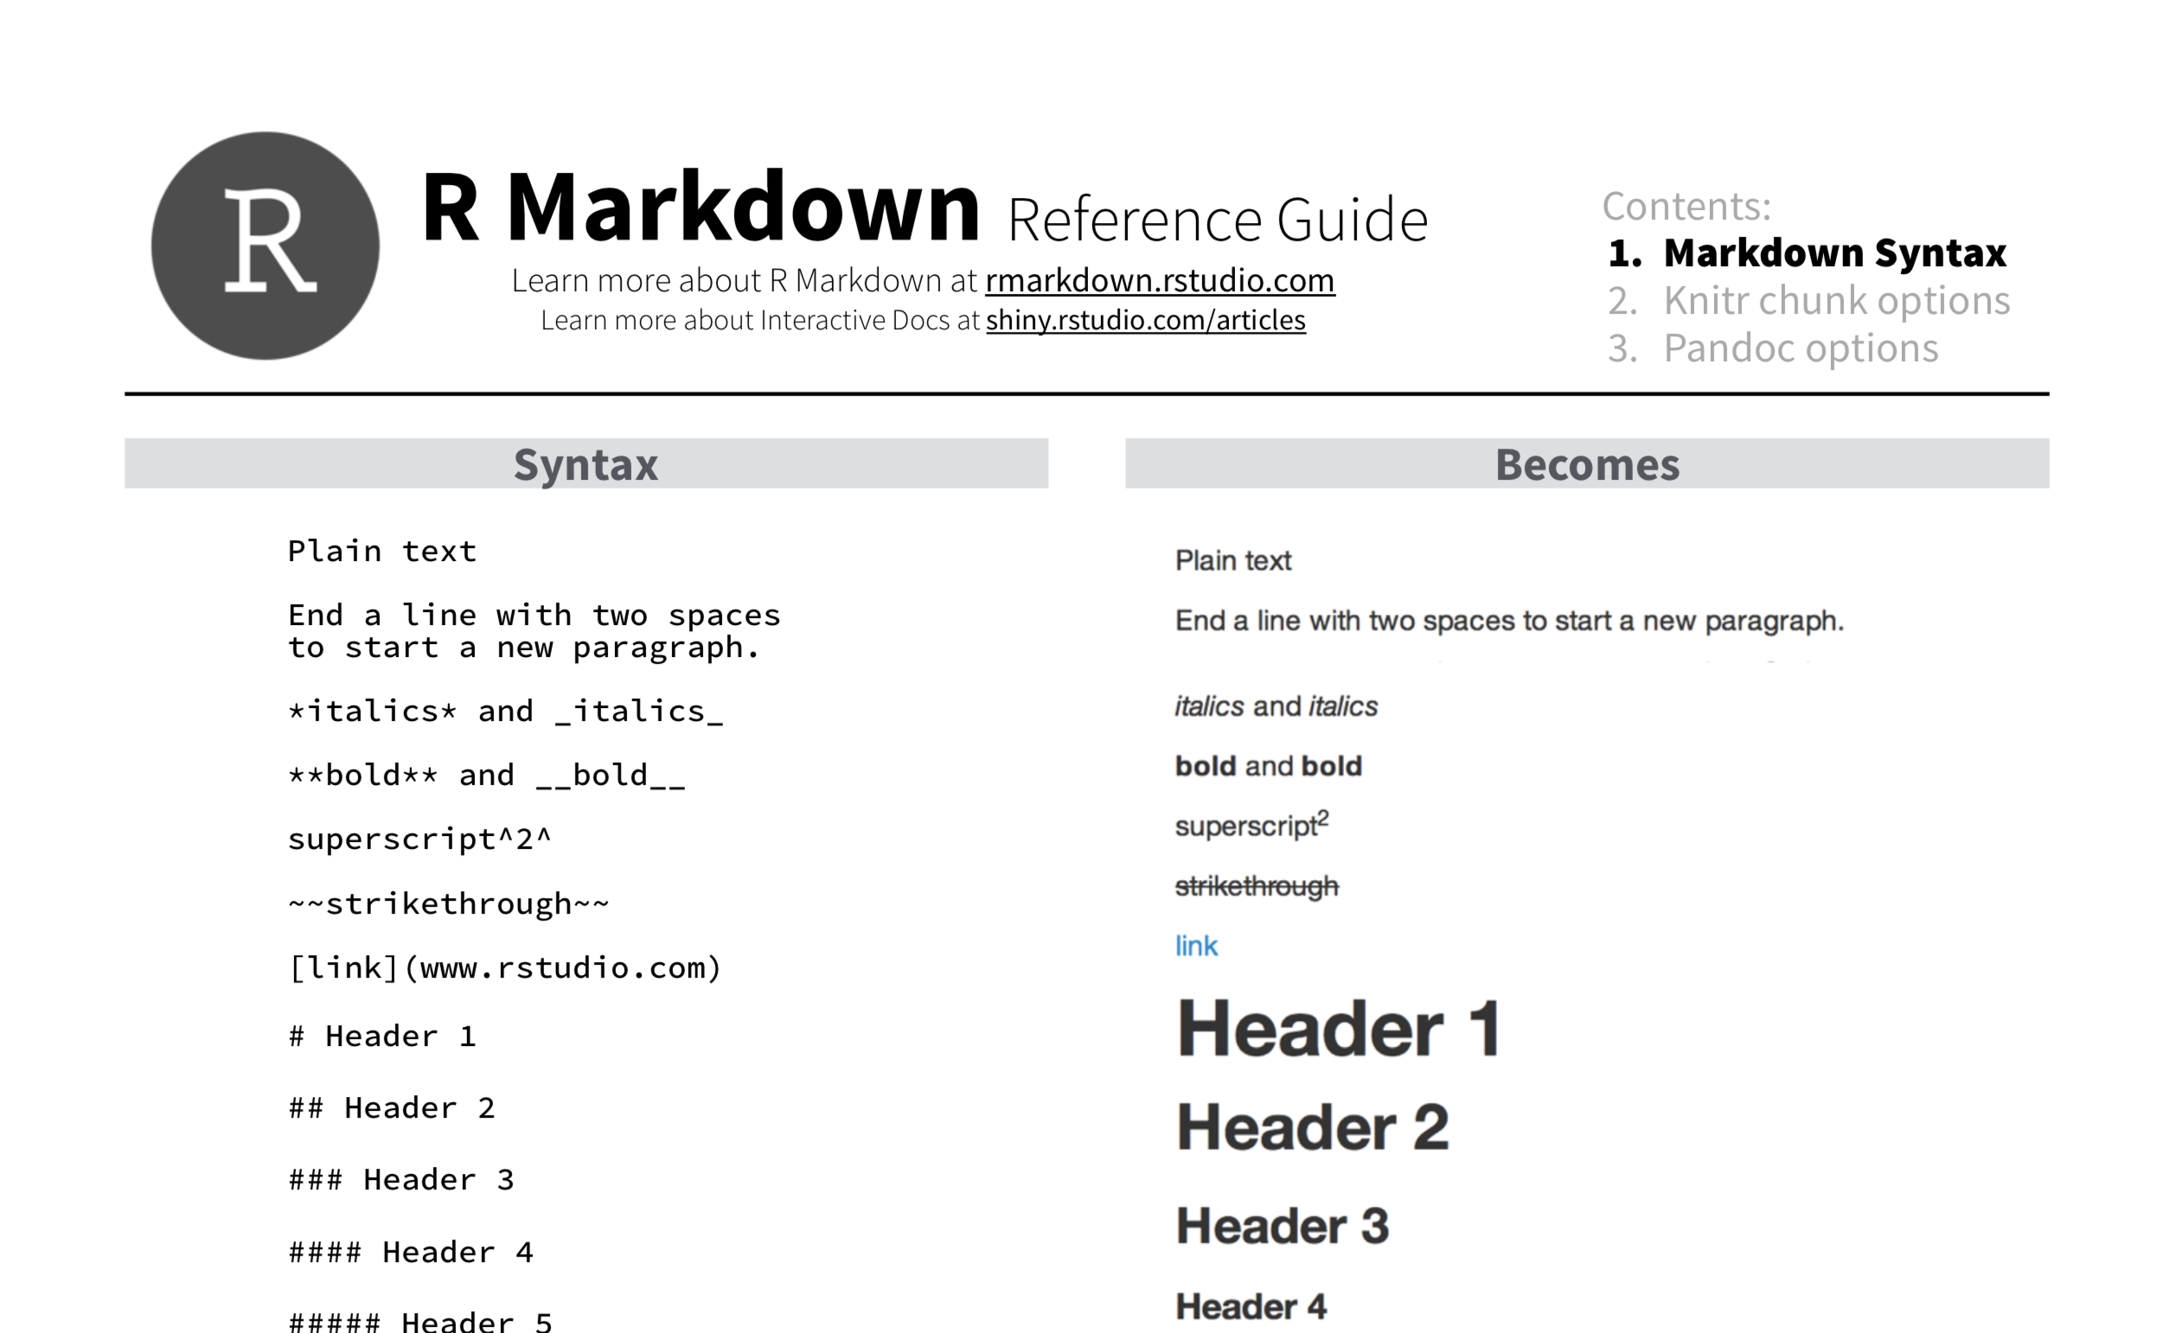
Notes:
As you do that, you might want to refer to the R Markdown Reference guide which gives you details about R Markdown syntax.
** put link into chat: https://www.rstudio.com/wp-content/uploads/2015/03/rmarkdown-reference.pdf
I just posted a link to this in the chat. And I thought I’ll give you about 5 minutes to play with this, and then I’ll go over it on my end.
** Then do a demo

Slide 51
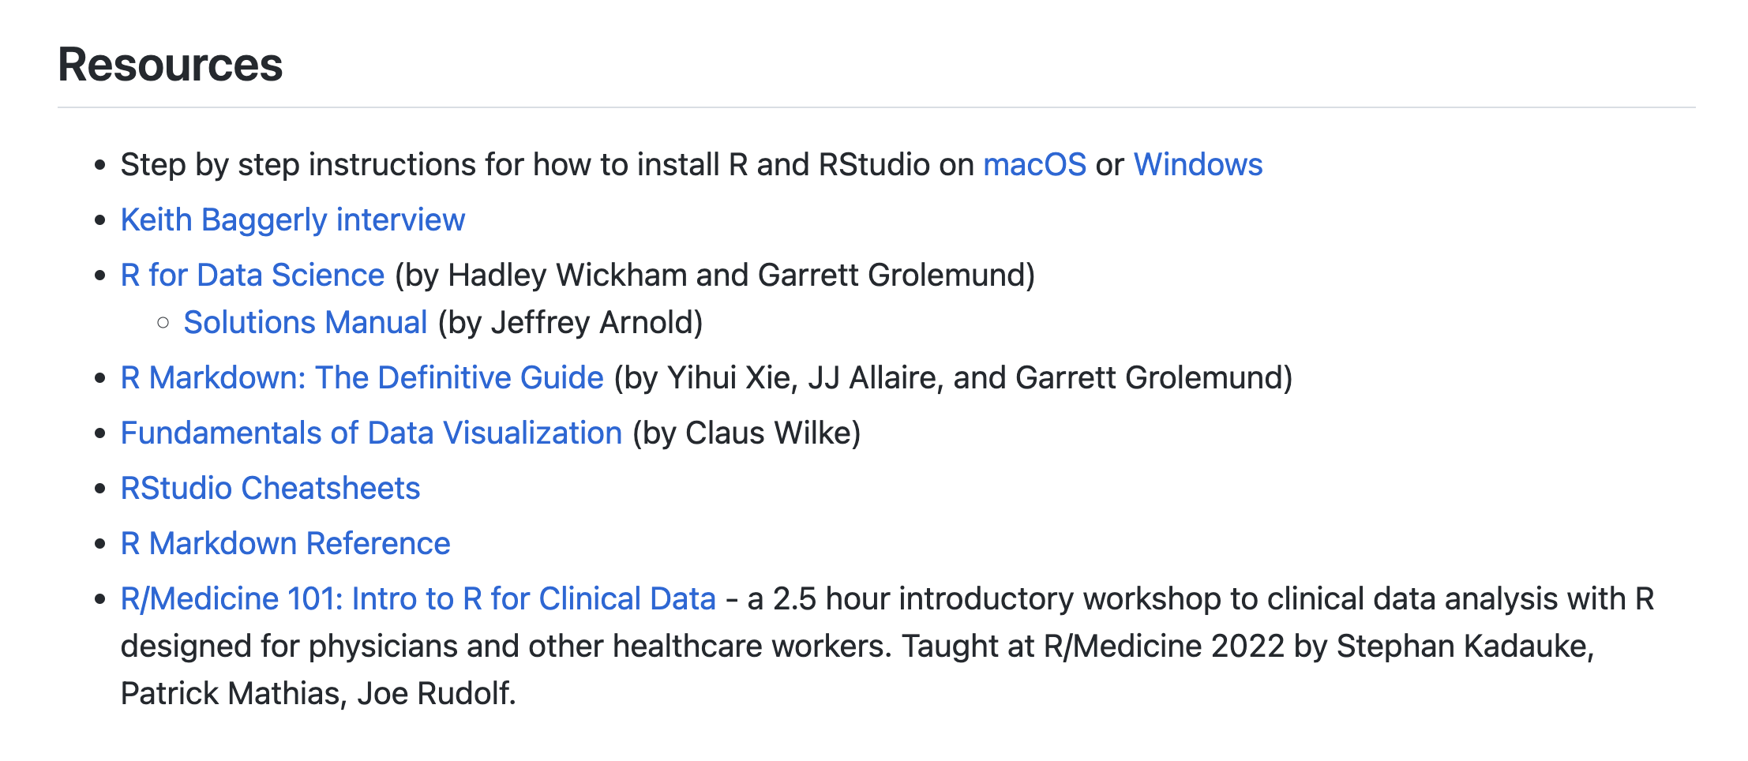
https://github.com/skadauke/rmd-teaching-stanford-2022
Notes:
Also, as promised, I’m posting a link to the website I made for this lecture with has the slides and a couple of resources for you to explore:
** Paste: https://github.com/skadauke/rmd-teaching-stanford-2022
That website will stay up forever, but the training environment will go away. But you can install R and R Markdown on your own computer if you want to practice more (and I think you SHOULD!). I have a video with step by step instructions for Mac and Windows on the website.

Slide 52
Thank You!
Email me at:
KadaukeS@chop.edu

